Slide 1
NSI Board Report
CWE NSI Board MEETING
February 2024
Prepared By: Sarah Wickenhauser

Slide 2
Agenda
Call to order
Meeting Minutes approval – vote
Financial Report – vote
NSI Staff Reports

Slide 3
Meeting Minutes – January 2024

Slide 4
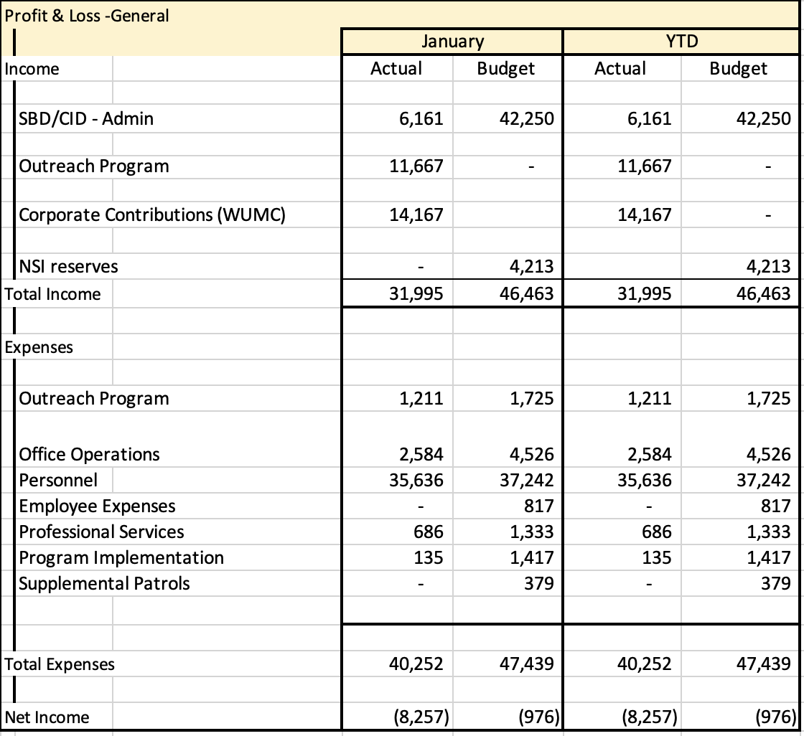
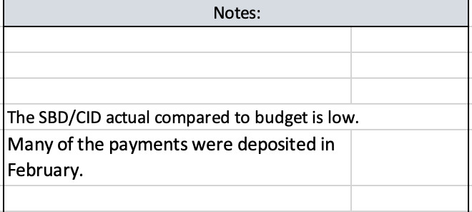
Financial Report – January 2024

Slide 5
Reports
Outreach Report
Camera Report
Executive Director Report

Slide 6
CWE NSI Executive Director Report February 2024
Jim Whyte
The Central West End Neighborhood Security Initiative
447 N. Euclid Ave, St. Louis, MO 63108
jwhyte@cwensi.com
314.454.5808

Slide 7
Updates
Eli Horner has been hired as the new Outreach Director. He started on January 22nd, 2024.
I met with Lawrence Jones, Fox News, about security cameras and the NSI efforts to help police solve crimes.
I conducted an interview with KMOV News 4 about the rash of stolen cars in the CWE over the weekend of Feb. 3rd and 4th.
I reached out to SMS Novel about their drone platform and how it can be used to address safety and security. We are looking into scheduling a demo.
On January 24th, I attended a Zoom meeting with St. Louis Hills SBD and Park Central. We discussed security firms and cameras.
I attended the Westminster Tri-Block meeting and provided an update on crime in the area.

Slide 8
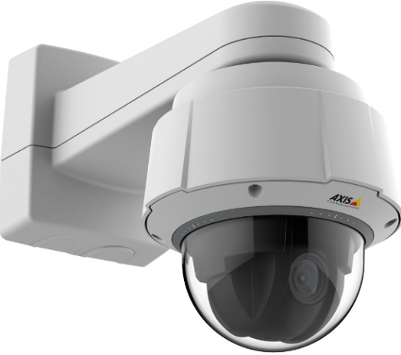
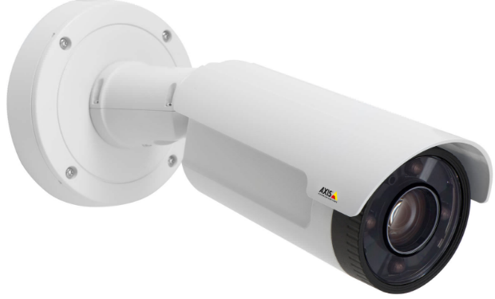
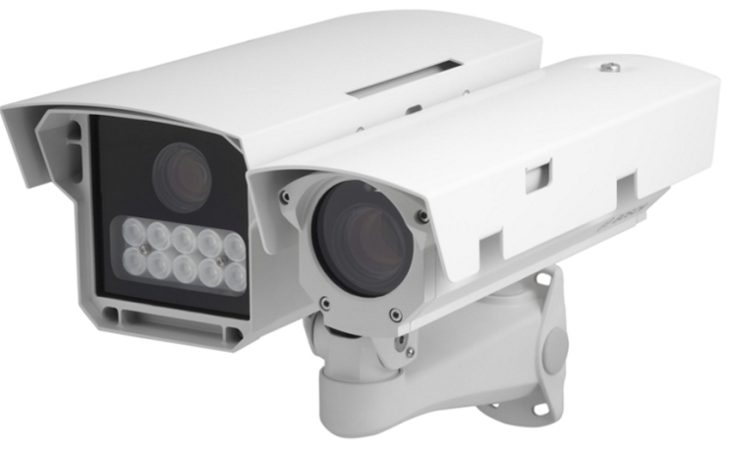
NSI Camera Project
February 19, 2024

Slide 9
Camera Management Information:
The Central West End neighborhood has 31 camera sites with 186 cameras having 318 views and 1 Flock camera.
DeBaliviere has 6 sites with 40 cameras having 68 camera views.
FPSE has 13 sites with 57 cameras having 133 camera views and 4 Flock cameras.
Loop East: (2) Camera sites with 10 cameras with 26 camera views.
Total Number of Camera Sites: 52
Total Number of Cameras: 293
Total Number of Camera Views: 545
Total Number of Flock Cameras: 5

Slide 10
Pending Camera Projects
5600- 5622 DeBaliviere- Replace/ upgrade displaced cameras on building. Upgrade/ add additional Cameras. (Complete)
4255 West Pine (Rejis)- Upgrade external cameras on building and install pole at intersection- On Hold. Meeting 2/15/2024
4502 Laclede- Upgrade and install new cameras at this site. (Complete).
40 N. Euclid- Replace NVR and upgrade camera. (Complete)
#26 Maryland Plaza- Total upgrade to this system. (Complete)
4398 and 4400 Chouteau- Establish 2 new camera sites. (Complete)
4511 West Pine- Upgrade cameras & Internet at this site. (Complete).
4321 Chouteau- Establish a new camera site. (Equipment has been delivered. Waiting on construction)
Recommendation for Camera upgrades and establish new sites in the CWE South SBD and Euclid South CID.

Slide 11
Pending Projects continued
4503 McPherson- Due to the overgrowth of trees and bushes conduct a site visit. Upgrade and install additional cameras at this site. (Complete).
4909 Laclede- Upgrade cameras at this site. Walk through scheduled 11/21/2023. (Processing)
4949 West Pine- Upgrade cameras at this site. Walk through scheduled 11/21/2023. (Processing)
398 N. Euclid- Establish a new camera site at this location. (Walk through completed. Proposal Submitted/Approved)
625 N. Euclid- Establish New site. Walk through scheduled 2/21/2024.

Slide 12
Camera Review Information
From January 1, 2024 to February 15, 2024
Total camera reviews: 17
Total arrests relative to reviews: 8
Total wanted(s): 1
Total vehicle wanted(s):

Slide 13
24-003451 UUW/Flourishing/ Theft 4907 West Pine on 01/25/2024 at 00:53am
The NSI received information relative to a UUW Flourishing that occurred in the area of West Pine and Euclid.
The victim/witness were walking to their apartment building when the victim observed the suspect kneeling behind the above vehicle, removing the license plate.
The victim confronted the suspect; however, was met by the suspect producing an unknown style silver firearm and pointing it at the victim.
The victim walked away, entered his apartment complex and called the police.
Suspect: Black male wearing all dark clothing, red shoes, with a backpack, armed with an unknown style silver firearm.
Video review shows the described suspect tampering with a vehicle and in the area at the time of the incident.
Suspect was arrested the next day after he was observed walking north on Euclid.
Suspect was identified as being Romel Minnis known offender of the CWE.

Slide 14
24-004331- Burglary 4534 Olive on 01/30/2024 at 12:20pm
NSI learned of a residential burglary incident at 4534 Olive.
Video review shows a suspect, known to the NSI as: DeAndre Mitchell.
Video shows Mitchell walking west in the south alley of the 4500 block of Olive.
Mitchell can be seen walking to the rear of the apartment building.
Mitchell unlawfully entered the apartment by breaking the bedroom window.
Mitchell was involved in the following incidents: 5622 Delmar on 01/24, 5601 Delmar on 01/24, 5200 Delmar on 02/01.
He was arrested on 2/5/2024 in the 800 block of Goodfellow after a foot pursuit.

Slide 15
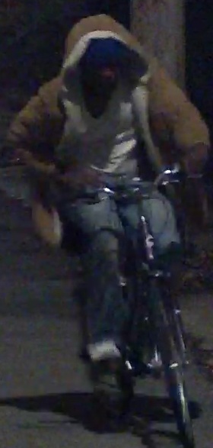
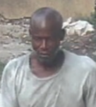
24-005666- Burglary 5275 Westminster on 2/9/24 at 1:15 am
The NSI received information relative to a garage burglary at 5275 Westminster.
Video review was conducted at which time the NSI was able to identify known burglar Geanard Howard.
This subject has been also involved in several garage burglaries around 4500 Westminster Pl. (Stolen Bike) and possibly 4300 Westminster Pl.
Suspect is not in custody, however Police stated he would be placed “Wanted” for this crime.
Please lock your residences, gates and garages.

Slide 16
NSI Outreach Program Updates
January 2024

Slide 17
January 2024 – 45 Total Engagements of 26 Individuals

Slide 18
January 2024 – Demographics of Engaged Individuals

Slide 19
Latest Developments: NSI Outreach was able to build enough rapport with this individual to not only convince her that she needed to leave her belongings and to go indoors during the winter cold front, but also assisted in securing that shelter bed for her.

Slide 20
61 Total Individual Engagements between Nov 12-Dec 12, 2023
(314) 970 - 2041

