Slide 1
CWE NSI Executive Director Report March 2024
Jim Whyte
The Central West End Neighborhood Security Initiative
447 N. Euclid Ave, St. Louis, MO 63108
jwhyte@cwensi.com
314.454.5808

Slide 2
Meeting Minutes – February 2024

Slide 3
Updates
I have asked our attorney to review and update our MOU with the SLMPD regarding the sharing of our security cameras and related video.
I have been subpoenaed to testify in the murder trial of Phillip Cutler in Federal Court. Cutler is accused of conspiracy to commit murder for hire and of Jocelyn Peters in 2016 and her unborn child. The cameras played a major role in the investigation of the crime.
I am meeting with members of the Lafayette Park Security Committee soon to discuss our organization and current trends in the City.

Slide 4
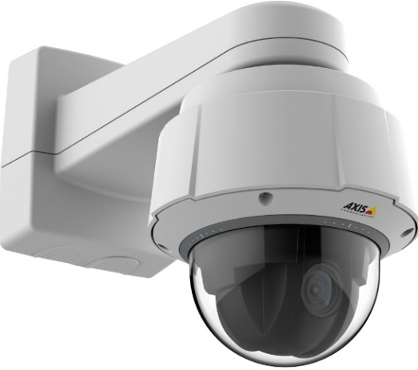
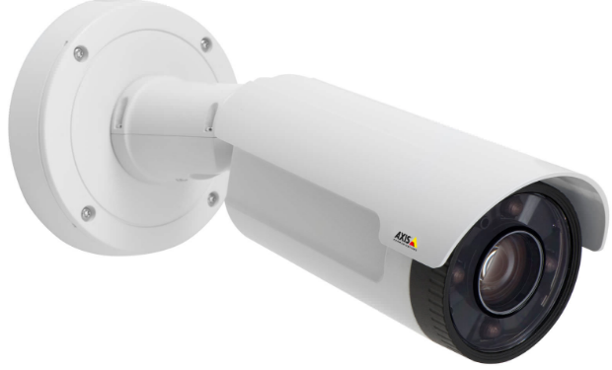
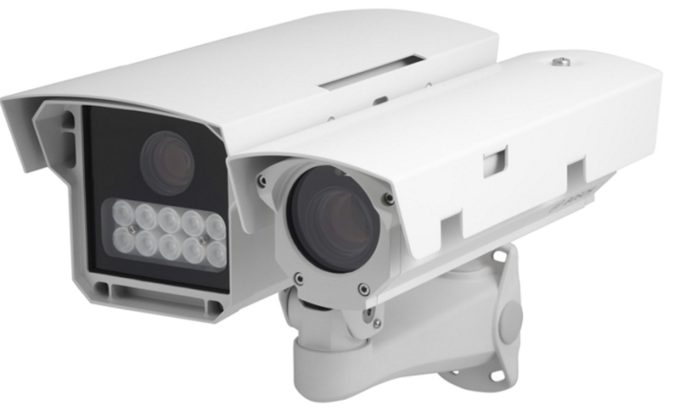
NSI Camera Project
March 21, 2024

Slide 5
Camera Management Information:
The Central West End neighborhood has 31 camera sites with 186 cameras having 318 views and 1 Flock camera.
DeBaliviere has 6 sites with 40 cameras having 68 camera views.
FPSE has 13 sites with 57 cameras having 133 camera views and 4 Flock cameras.
Loop East: (2) Camera sites with 10 cameras with 26 camera views.
Total Number of Camera Sites: 52
Total Number of Cameras: 293
Total Number of Camera Views: 545
Total Number of Flock Cameras: 5

Slide 6
Camera Review Information
From January 1, 2024 to March 21, 2024
Total camera reviews: 31
Total arrests relative to reviews: 8
Total wanted(s): 1
Total vehicle wanted(s):

Slide 7
Pending Camera Projects
4255 West Pine (Rejis)- Upgrade external cameras on building and install pole at intersection- On Hold. Meeting 2/15/2024
4321 Chouteau- Establish a new camera site. (Equipment has been delivered. Waiting on construction)
4476 Chouteau (Song Bird)- Establish a new camera site at this location.
Recommendation for Camera upgrades and establish new sites in the CWE South SBD and Euclid South CID.

Slide 8
Pending Projects continued
4909 Laclede- Upgrade cameras at this site. (Pending)
4949 West Pine- Upgrade cameras at this site. (Pending)
398 N. Euclid- Establish a new camera site at this location. (Walk through completed. Proposal Submitted/Approved)
625 N. Euclid- Establish New site.

Slide 9
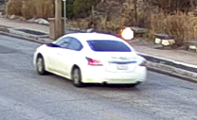
24-007939 Shots Fired into a Dwelling 4349 Gibson on 2/25/2024 at 5:54 pm
NSI was sent information about “shots fired” into an apartment building at 4349 Gibson.
It was reported that a white, Chevy Impala was involved.
Video review of security cameras in the area showed the vehicle involved to be a white, Nissan Altima with Missouri plates of GF4-G0G.
Video and images were forwarded to Police.

Slide 10
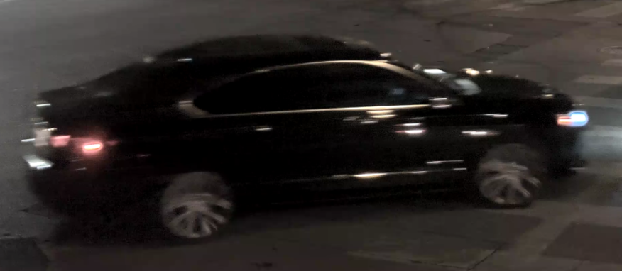
24-008710 Theft of a MV on 03/01/2024 at 7:19 pm
NSI was contacted by email from the victim and witness, a neighbor, advising of the theft of her 2015 Kia Soul.
Witness advised a dark car and multiple suspects were involved.
NSI video review shows a black, Checy Impala, 4dr, occupied by 4 subjects in the area of the theft.
We see the Impala pull into the east driveway of 4501 Maryland and let two subjects out of the car.
Later we see the occupants of the Chevy Impala break into a car on the south side of Maryland, east of Taylor.
As the stolen Kia and Impala head west on Maryland, one of the occupants of the Kia jumps out at Euclid and tries opening the car door of a parked vehicle as the owner walks away.
Both vehicles last seen heading north on Kingshighway from Maryland.

Slide 11
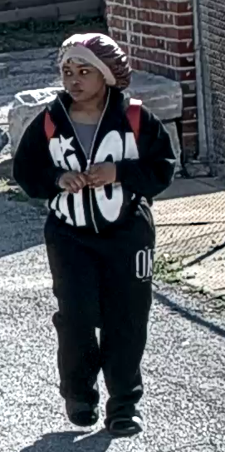
24-009367 Carjacking 4309 Chouteau 3/06/2024 at approximately 09:40 am
The NSI Camera Team received information relative to a “Carjacking” that occurred at 4309 Chouteau.
The victim was sitting inside his vehicle, when two suspects walked up to his driver's side door and told the driver to get out of his vehicle.
The suspects were described as:
B/M 20-25 years old, 6'0", white/black jacket, skinny build, dark complexion, and wearing a dark ski mask.
B/F 20-25 years old, 5'05", gray sweatpants, gray sweatshirt, large build, dark complexion, and wearing a dark ski mask.
The male suspect had his hand inside his waistband. Believing that the male suspect had a weapon the victim complied.
Both suspects got into the vehicle and traveled westbound on Chouteau Ave out of sight.
The victim vehicle was a Gray 2023 Toyota Camry with Michigan license plate 02923RF (2024).
A review of the cameras in the area revealed the stolen vehicle as well as the suspects.

Slide 12
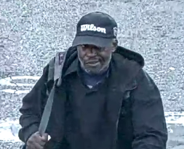
CWE Burglary Suspect
2024 Burglaries
2/9- Theft of a Lawn Mower 4719 Westminster
2/9- Stole bike from 226 N. Euclid
2/9- Stole bike from 4500 block of Westminster
2/9- Stolen Lawn Equipment 5275 Westminster
2/13- Stole Lawn equipment #91 Waterman Pl.
2/15- Trespassing 4454 Lindell
2/10- Trespassing 4393 Westminster
2/21- Burglary 5015 Westminster (Abated by Death)
Prolific Burglar Geanard Howard was shot after breaking into an occupied dwelling.

Slide 13
NSI Outreach Program Updates
February 2024

Slide 14
February 2024 – 51 Total Engagements

Slide 15
February 2024 – 51 Total Engagements

Slide 16
February 2024 – Demographics of Engaged Individuals

Slide 17
Feburary 2024 – Demographics of Engaged Individuals

Slide 18
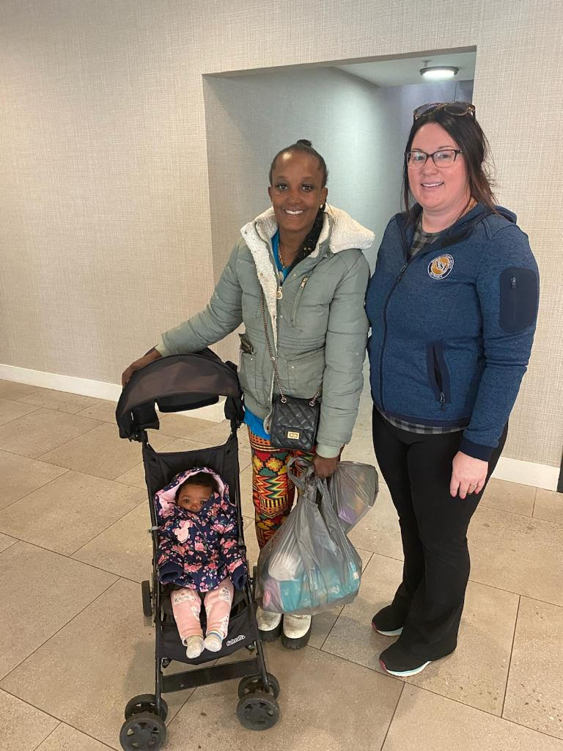
Latest Developments: Outreach encountered this woman with her 8-month-old baby sitting on the steps of Trinity church. She was attempting to find shelter using 211 hotline. She was not successful. Due to the severity of this situation outreach and Jim were able to collaborate to get her a temporary hotel until shelter was available. Yusef assisted us in getting her into Loaves and Fishes shelter, but due to a previous encounter there she was not comfortable going back. A second shelter was attempted for her but unfortunately, she declined. We all agreed this situation required hot lining DFS for the safety of the child. She is still on our radar but refuses any help at this point due to mental illness.

Slide 19
61 Total Individual Engagements between Nov 12-Dec 12, 2023
(314) 970 - 2041

