Slide 1
NSI Board Report
CWE NSI Board MEETING
May 2024
Prepared By: Sarah Wickenhauser

Slide 2
Agenda
Call to order
Meeting Minutes approval – vote
Financial Report – vote
NSI Staff Reports

Slide 3
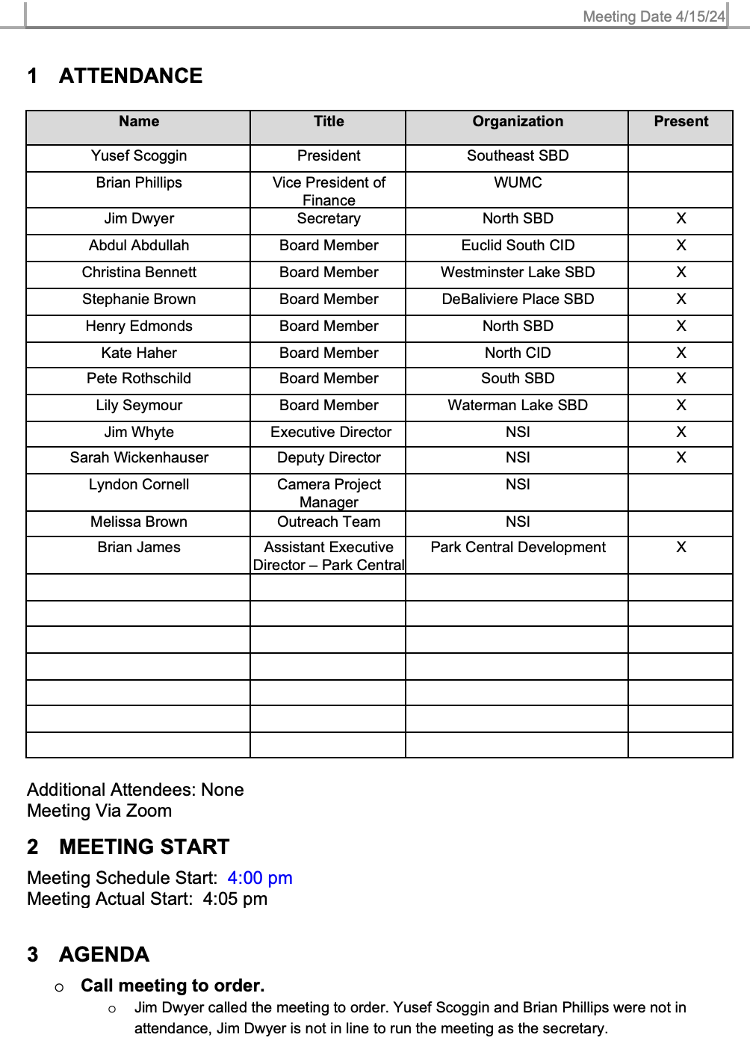
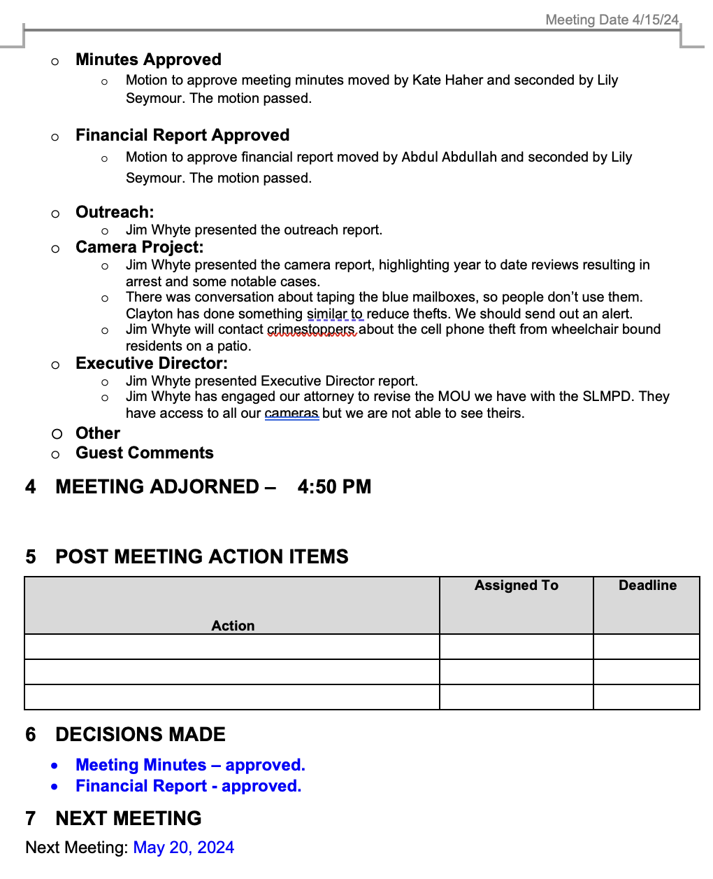
Meeting Minutes – April 2024

Slide 4
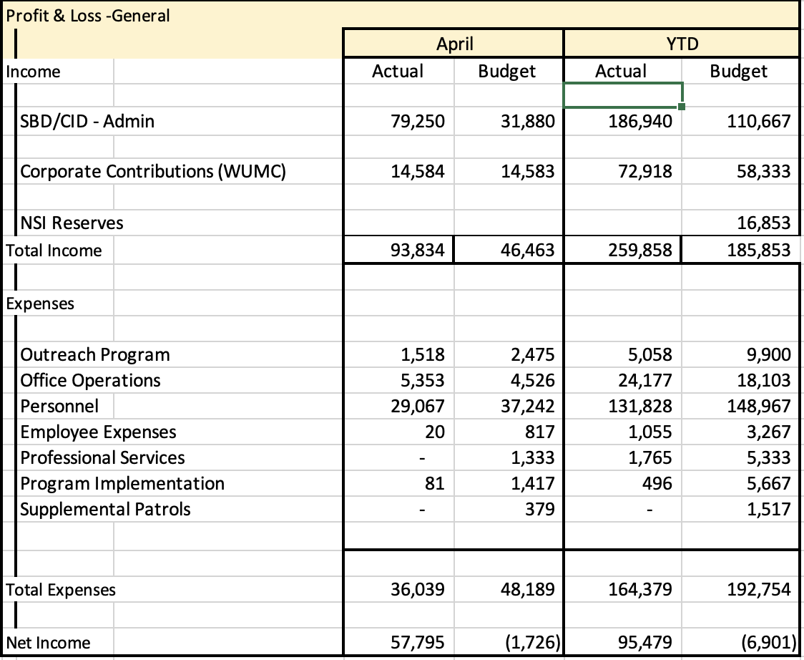
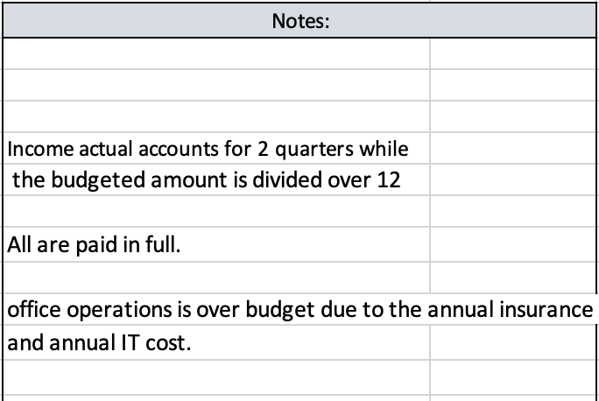
Financial Report – April 2024

Slide 5
Reports
Camera Report
Executive Director Report
Outreach Report

Slide 6
CWE NSI Executive Director Report May 2024
Jim Whyte
The Central West End Neighborhood Security Initiative
447 N. Euclid Ave, St. Louis, MO 63108
jwhyte@cwensi.com
314.454.5808

Slide 7
Updates
The NSI is now working with The Modern Social who has been selected to expand our brand, increase awareness of the NSI and address crime through social media platforms.
I have met with the following leaders, over the last month, from the SLU Schools of Social Work and Criminal Justice. The purpose was to explain what the NSI is about and discuss possible opportunities.
Noelle Fearn, Dean, SLU School of Social Work, Criminology & Criminal Justice.
Kenya Brumfield-Young, Assistant Professor, Internship Coordinator, Criminology and Criminal Justice.
Wendy DuCasse, Director of Field Education.
Jesse Helton, Associate Professor, Social Work.

Slide 8
Updates
I attended the 9th Ward Town Hall meeting and discussed the Outreach Program.
I attended the annual meeting with the residents of the Donegal Condominiums at 4525 Laclede. Circuit Court judges attended also.

Slide 9
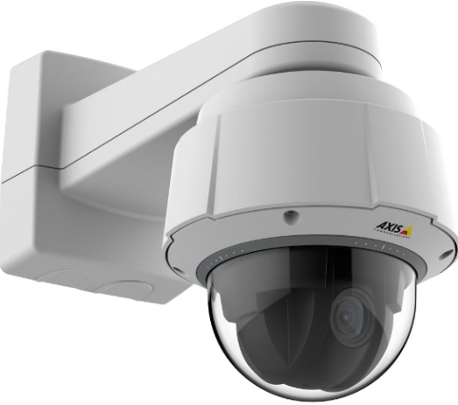
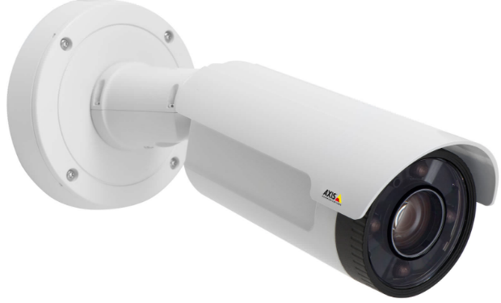
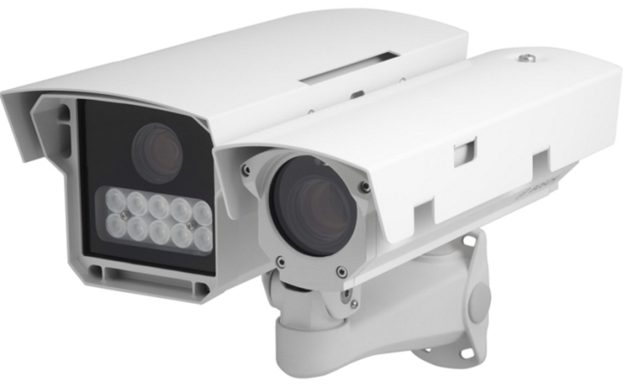
NSI Camera Project
May 20, 2024

Slide 10
Camera Management Information:
The Central West End neighborhood has 31 camera sites with 195 cameras having 330 views and 1 Flock camera.
DeBaliviere has 6 sites with 40 cameras having 68 camera views.
FPSE has 13 sites with 57 cameras having 133 camera views and 4 Flock cameras.
Loop East: (2) Camera sites with 10 cameras with 26 camera views.
Total Number of Camera Sites: 52
Total Number of Cameras: 302
Total Number of Camera Views: 557
Total Number of Flock Cameras: 5

Slide 11
Camera Review Information
From January 1, 2024 to May 20, 2024
Total camera reviews: 65
Total arrests relative to reviews: 13
Total wanted(s): 1
Total vehicle wanted(s):

Slide 12
Pending Camera Projects
4255 West Pine (Rejis)- Upgrade external cameras on building and install pole at intersection- On Hold.
4321 Chouteau- Establish a new camera site. (Equipment has been installed. Programming)
4476 Chouteau (Song Bird)- Establish a new camera site at this location.
Recommendation for Camera upgrades and establish new sites in the CWE South SBD and Euclid South CID.

Slide 13
Pending Projects continued
398 N. Euclid- Establish a new camera site at this location. (Conduit and wiring installed)
625 N. Euclid- Establish New site. (Permission granted by property owner. Board Approved. Equipment ordered.)
4500 Olive- Establish a new camera site. Board Approved.

Slide 14
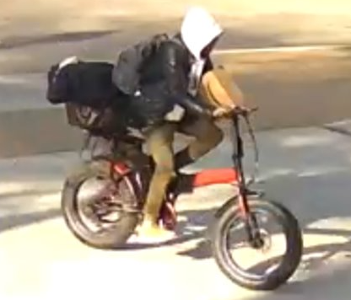
24-015606 Burglary 2nd/ Theft from a Building from 4545 Laclede on 4/15/2024 at approx 8:40 am
The property manager contacted the NSI relative to a package theft at the property.
The suspect arrived at the property riding a bike.
Images/ video was obtained of the suspect prior to/ after the Theft.

Slide 15
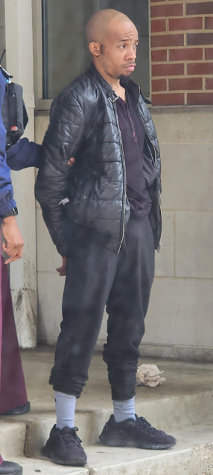
24-017157 Burglary 2nd/ Assault 3rd from 4545 Laclede on 4/28/2024 at approx 9:00 am
The NSI was contacted by the property manager at 4545 Laclede relative to a Burglary that occurred at their property.
The witness/ victim stated the suspect stole packages from the property on previous occasions and he attempted to hold the suspect until PD arrived.
The witness/ victim stated the suspect bit him on his hand and fled.
On 4/29/2024, the suspect was observed standing in front of the Library and the police was contacted. He was placed under arrest.
ARRESTED

Slide 16
24-017867 Robbery 1st – Carjacking 5150 Waterman on 05/02/2024 at 6:28pm
The NSI was contacted and advised of a “carjacking” at 5150 Waterman involving 4 suspects.
Suspects were (4) B/M's, 5'10''-6'11'', thin build, wearing dark color clothing and 1 was wearing a blue shirt. At least 2 were armed with firearms.
Stolen Vehicle was a 2014 red Chrysler 200, bearing Missouri license plate LH9V6S.
The vehicle was last seen travelling east on Waterman and North on N. Kingshighway.
Video review by NSI shows 4 suspects walking east on Delmar, south on Clara, east on Pershing, north on Union then east on Waterman to the incident location.
Detectives arrested (2) of the (4) suspects after observing the carjacked vehicle in the area of Delmar/ Goodfellow. Suspects fled and was apprehended shortly after a foot pursuit.
(2) Suspects were arrested. Attempting to identify (2) suspects that escaped.

Slide 17
24-019288 Murder 2nd 250 DeBaliviere on 5/11/2024 at 3:23 pm
The NSI received information relative a Homicide that occurred on the Metro platform.
Images / video of the suspect were captured of the suspect prior to/ after the incident.
The suspect was arrested on 5/12/2024.
ARRESTED

