Slide 1
NSI Board Report
CWE NSI Board MEETING
April 2024
Prepared By: Sarah Wickenhauser

Slide 2
Agenda
Call to order
Meeting Minutes approval – vote
Financial Report – vote
NSI Staff Reports

Slide 3
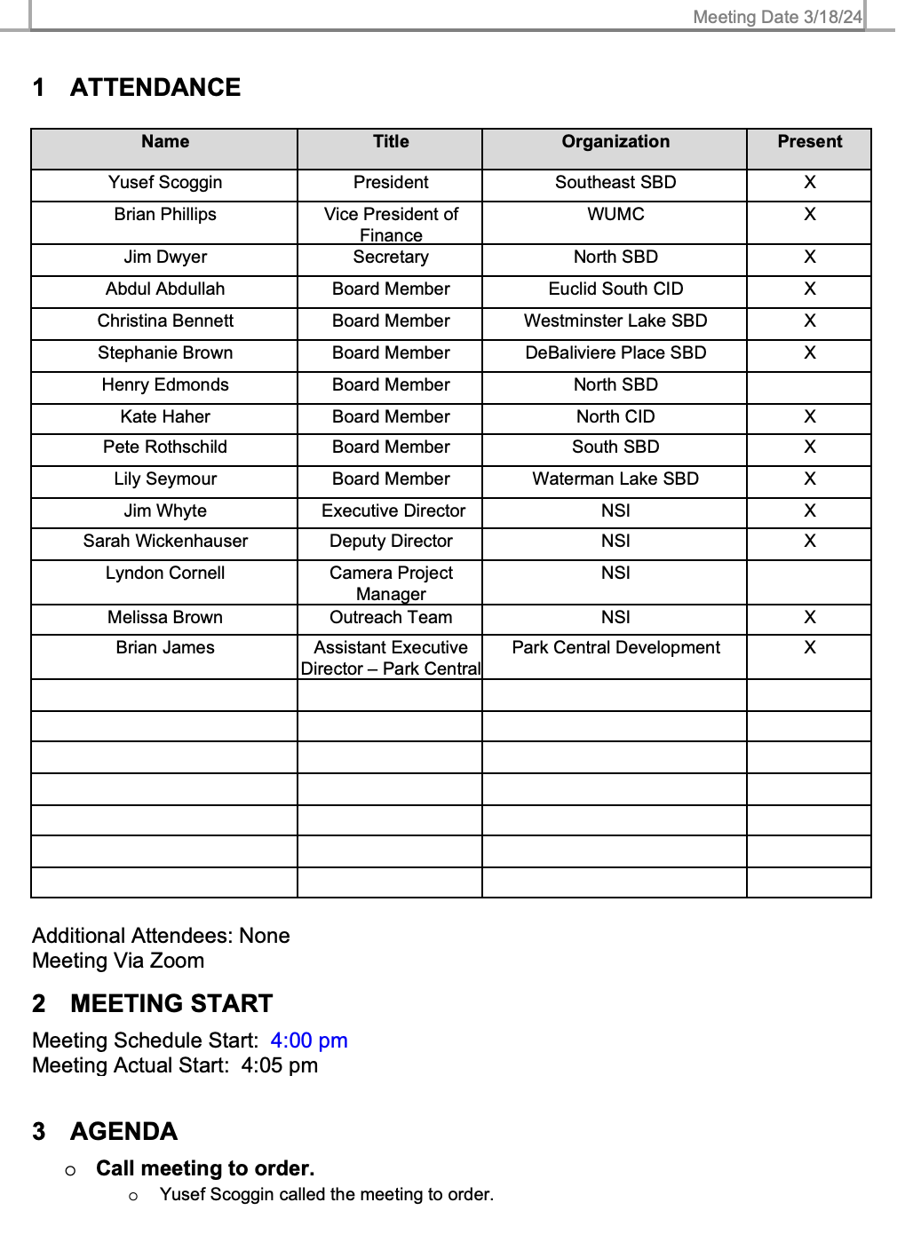
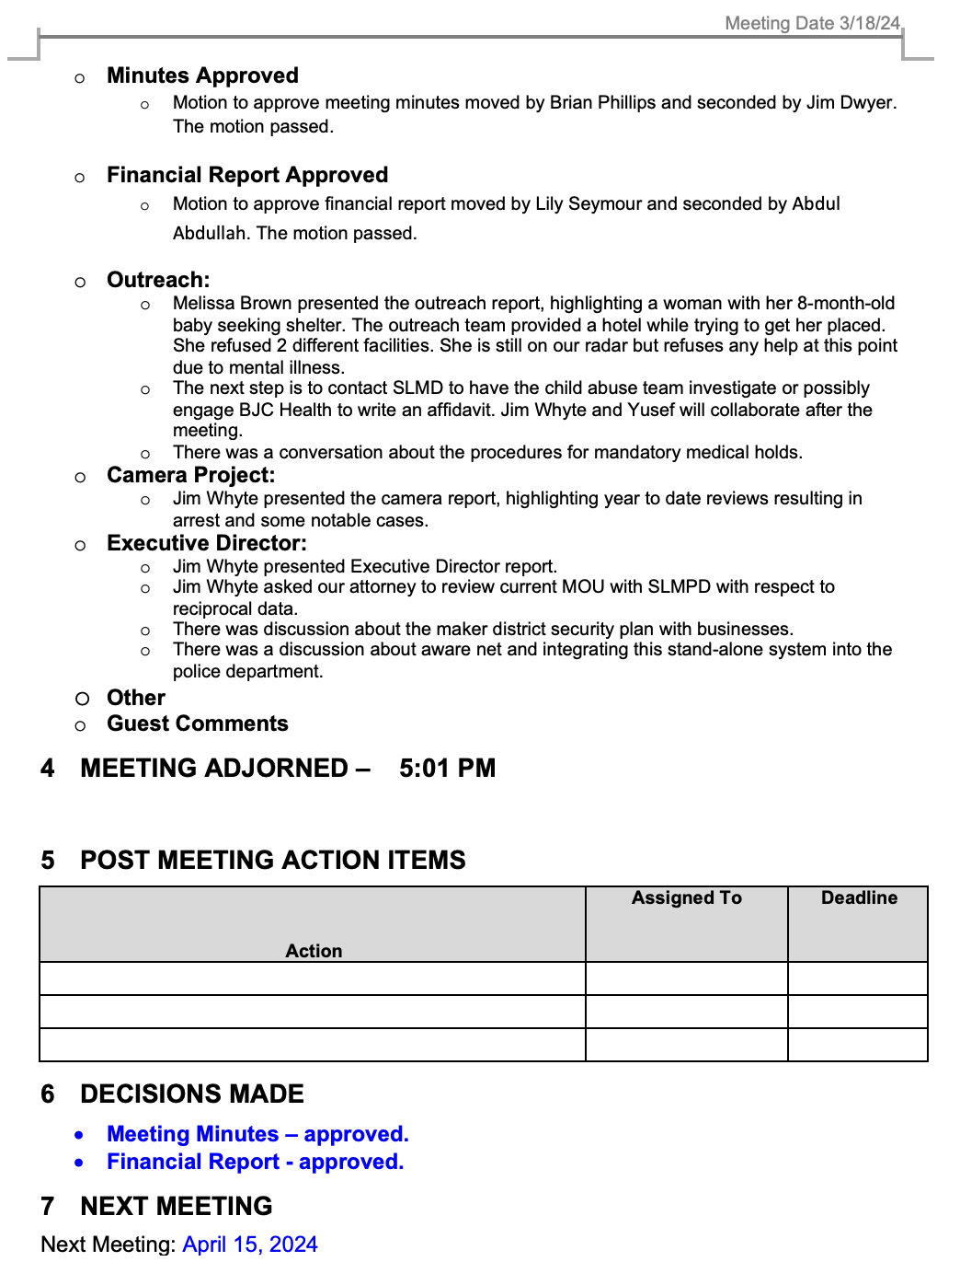
Meeting Minutes – March 2024

Slide 4
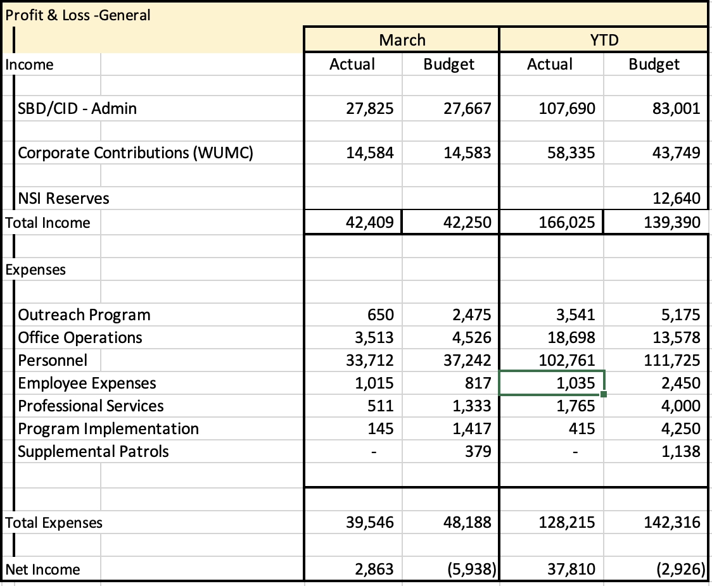
Financial Report – March 2024

Slide 5
Reports
Outreach Report
Camera Report
Executive Director Report

Slide 6
CWE NSI Executive Director Report April 2024
Jim Whyte
The Central West End Neighborhood Security Initiative
447 N. Euclid Ave, St. Louis, MO 63108
jwhyte@cwensi.com
314.454.5808

Slide 7
Updates
I have asked our attorney to review and update our MOU with the SLMPD regarding the sharing of our security cameras and related video.
Follow-Up to mom and her 8-month-old baby. She stopped communicating with our office and the Outreach Team. I filed a “hot line” report with DSS. We met with Investigator however he was not able to locate her.
I posted an alert over NextDoor and worked with local media to draw attention to the on-going theft issues with the blue, USPS, mailboxes.
Media did story on derelict and abandoned cars in and around the CWE and DeBaliviere Place. The story focused on City not responding to this issue in a timely manner.
I attended a Zoom meeting with Congresswoman Bush and federal funding grant requests for community projects.
I met with SLU professor of Social Work and Criminal Justice. There may be opportunities to collaborate on projects moving forward.

Slide 8
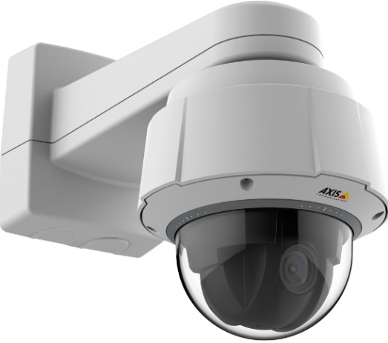
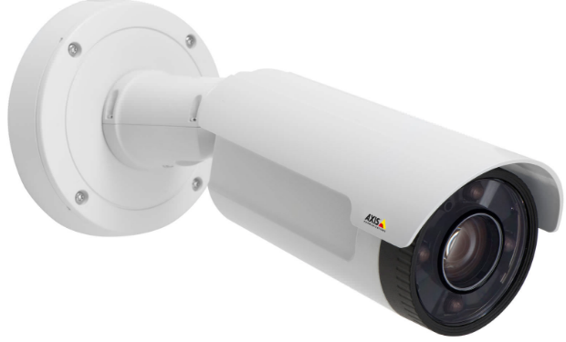
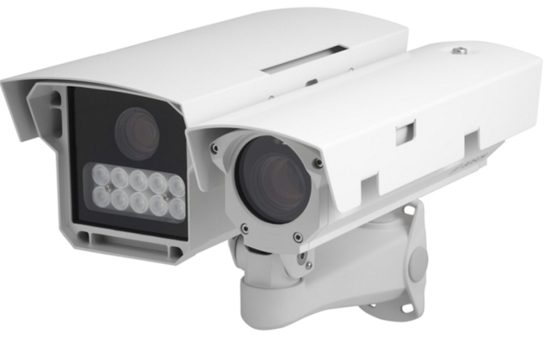
NSI Camera Project
April 15, 2024

Slide 9
Camera Management Information:
The Central West End neighborhood has 31 camera sites with 195 cameras having 330 views and 1 Flock camera.
DeBaliviere has 6 sites with 40 cameras having 68 camera views.
FPSE has 13 sites with 57 cameras having 133 camera views and 4 Flock cameras.
Loop East: (2) Camera sites with 10 cameras with 26 camera views.
Total Number of Camera Sites: 52
Total Number of Cameras: 302
Total Number of Camera Views: 557
Total Number of Flock Cameras: 5

Slide 10
Camera Review Information
From January 1, 2024 to April 15, 2024
Total camera reviews: 47
Total arrests relative to reviews: 9
Total wanted(s): 1
Total vehicle wanted(s):

Slide 11
Pending Camera Projects
4255 West Pine (Rejis)- Upgrade external cameras on building and install pole at intersection- On Hold. Meeting 2/15/2024
4321 Chouteau- Establish a new camera site. (Equipment has been delivered. Waiting on construction)
4476 Chouteau (Song Bird)- Establish a new camera site at this location.
Recommendation for Camera upgrades and establish new sites in the CWE South SBD and Euclid South CID.

Slide 12
Pending Projects continued
4909 Laclede- Upgrade cameras at this site. (Complete)
4949 West Pine- Upgrade cameras at this site. (Complete)
398 N. Euclid- Establish a new camera site at this location. (Conduit and wiring installed)
625 N. Euclid- Establish New site. (Permission granted by property owner. Need Board Approval.)

Slide 13
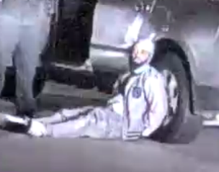
24-011267 Burglary 2nd/ Kidnapping/ Assault 1st LEO from 5510 Pershing on 3/20/2024 at 2:45 am
A radio assignment for a black male dressed in all grey clothing opening individual's car doors and riffling through them in the secured apartment buildings garage.
Police approached this suspect a which time he ran and attempted to get away.
The police attempted to remove him from his vehicle at which time the suspect drove off with the police inside of the vehicle.
The suspect was placed under arrest.
It should be noted that this suspect was also responsible for numerous break- ins and thefts from 4055 Laclede and 4100 Laclede.
ARRESTED

Slide 14
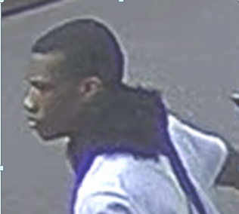
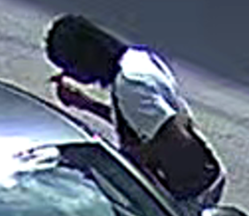
24-012876- Stealing of a Motor Vehicle #40 N. Euclid on 03/29/2024 at 7:24pm
Victim reported their vehicle stolen upon leaving Shake Shack.
Review of video cameras, at the reported location of the victim’s stolen vehicle, revealed the arrival of a suspects.
The suspects arrived in a Hyundai with Missouri plates EC8 L3S.
The male suspect approached the stolen car and breaks out the rear drivers-side window with a small hammer (tool).
The suspect then jumps headfirst into the stolen car and begins to work on the ignition area.
Moments later the car started and he follows the car he arrived at the scene in now driven by another occupant.

Slide 15
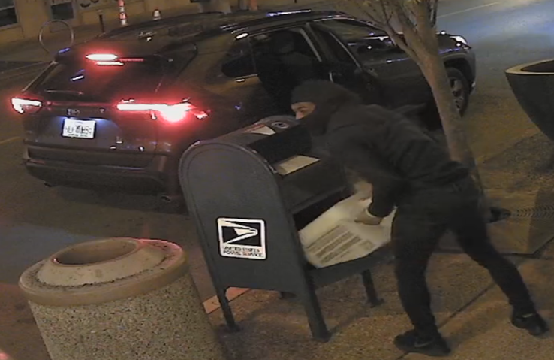
24-014051- Theft of Postal Services/Mailbox on 4/6/2024 at 4:30 am- 5:00 am Maryland @ Euclid/ Taylor @ Olive/ Euclid & Laclede/ Taylor & West Pine
ALERT
The NSI Camera Division was made aware of a Postal Mailbox theft that occurred at Laclede @ Euclid on 4/6/2024 at 4:51AM.
Cameras in the area was able to capture this incident.
While conducting their camera review the suspects were observed using a key to access the mail from the mailboxes throughout the CWE.
LPC camera at Olive and Taylor identified the plate as HLF H94.
Information was provided to the police as well as the US Postal Inspector.

Slide 16
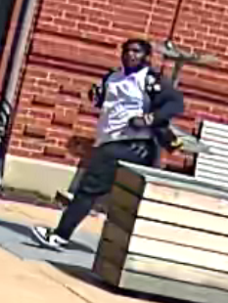
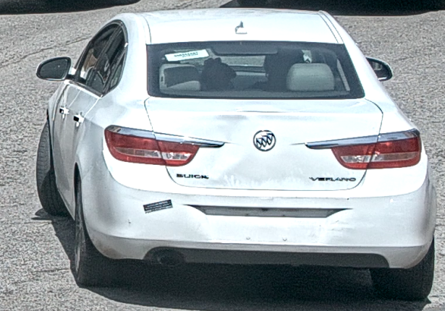
24-014052- Robbery from 4055 Laclede on 4/8/2024 at 12:52 pm
The NSI received information relative to a robbery that occurred at the above location.
A review of the cameras revealed a male suspect arrived in a white Buick Verano.
The vehicle parked on Sarah & Laclede facing north.
The suspect exit the passenger side of the vehicle and walked east on Laclede.
While walking back west the suspect stole the victim’s property and ran to the vehicle, which fled north on Sarah.

