Slide 1
NSI Board Report
CWE NSI Board Meeting
September 2024
Prepared By: Sarah Wickenhauser

Slide 2
Agenda
Call to order
Meeting Minutes approval – vote
Financial Report – vote
2025 Budget
NSI Staff Reports

Slide 3
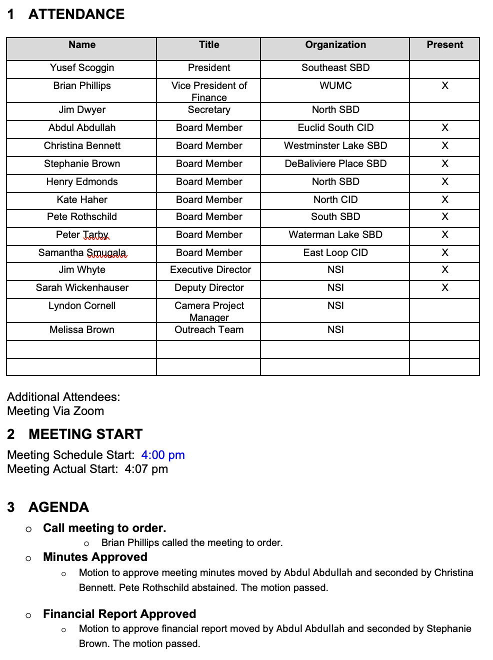
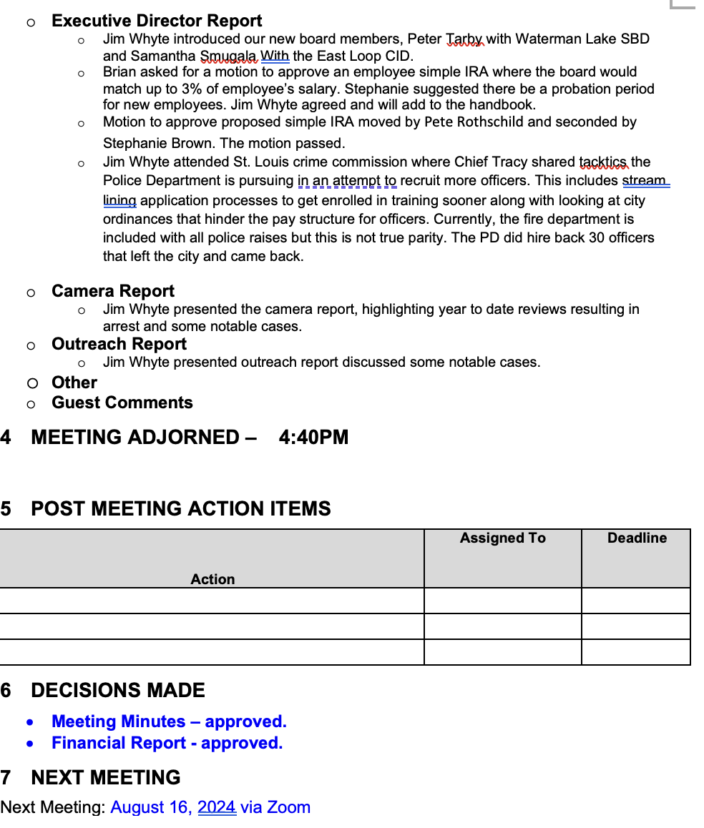
Meeting Minutes – August 2024

Slide 4
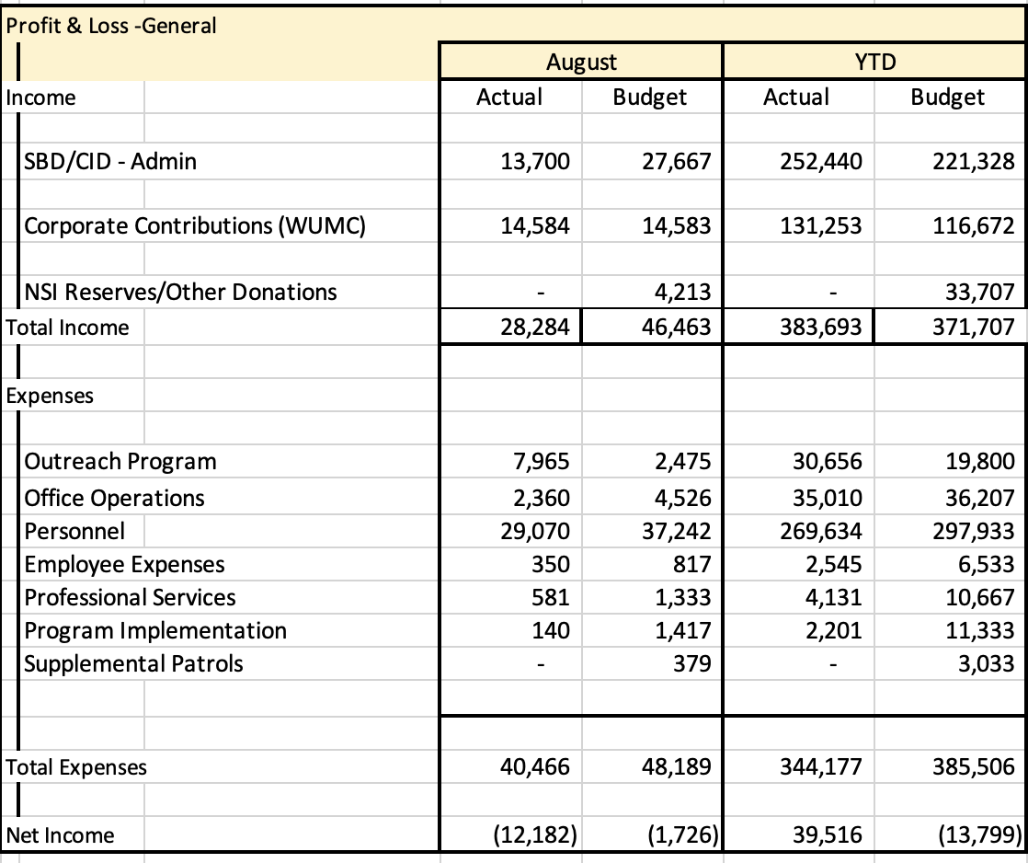
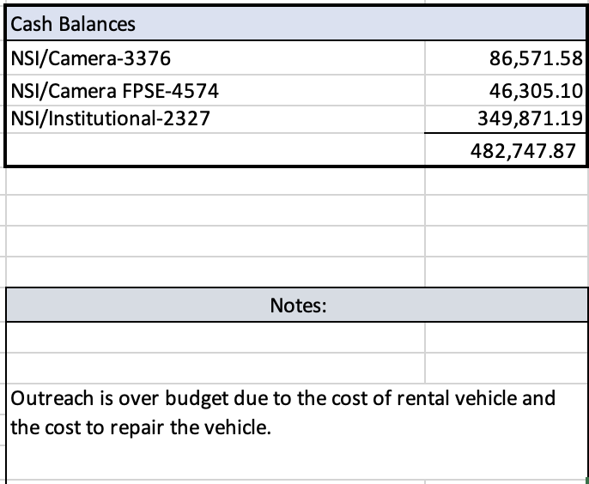
Financial Report – August 2024
Fourth quarter invoice will be sent this week.

Slide 5
2025 Budget

Slide 6
Reports
Executive Director Report
Camera Report
Outreach Report

Slide 7
CWE NSI Executive Director Report August 2024
Jim Whyte
The Central West End Neighborhood Security Initiative
447 N. Euclid Ave, St. Louis, MO 63108
jwhyte@cwensi.com
314.454.5808

Slide 8
Updates
The NSI staff were the invited guests of Captain Christi Marks, Commander, District 5, to the annual Police Foundation luncheon.
I met with the new management team of the Salvation Army facility at Forest Park and Vandeventer. Jesse Links is the new Administrator for Business and has previous success in Indiana.
An introduction was made between the NSI and Peacemakers Security Group. They are a local security service provider.
I attended the annual homeowners meeting at the Residences at the Chase Park Plaza.

Slide 9
Social Media Analytics

Slide 10
Fundraiser

Slide 11
NSI Outreach: August-Sept 2024 Update
Alvin Ferguson & Melissa Brown

Slide 12
61 Total Individual Engagements between June-July 2024

Slide 13
Locations of CWE NSI Outreach Engagements between June-July 2024:

Slide 14
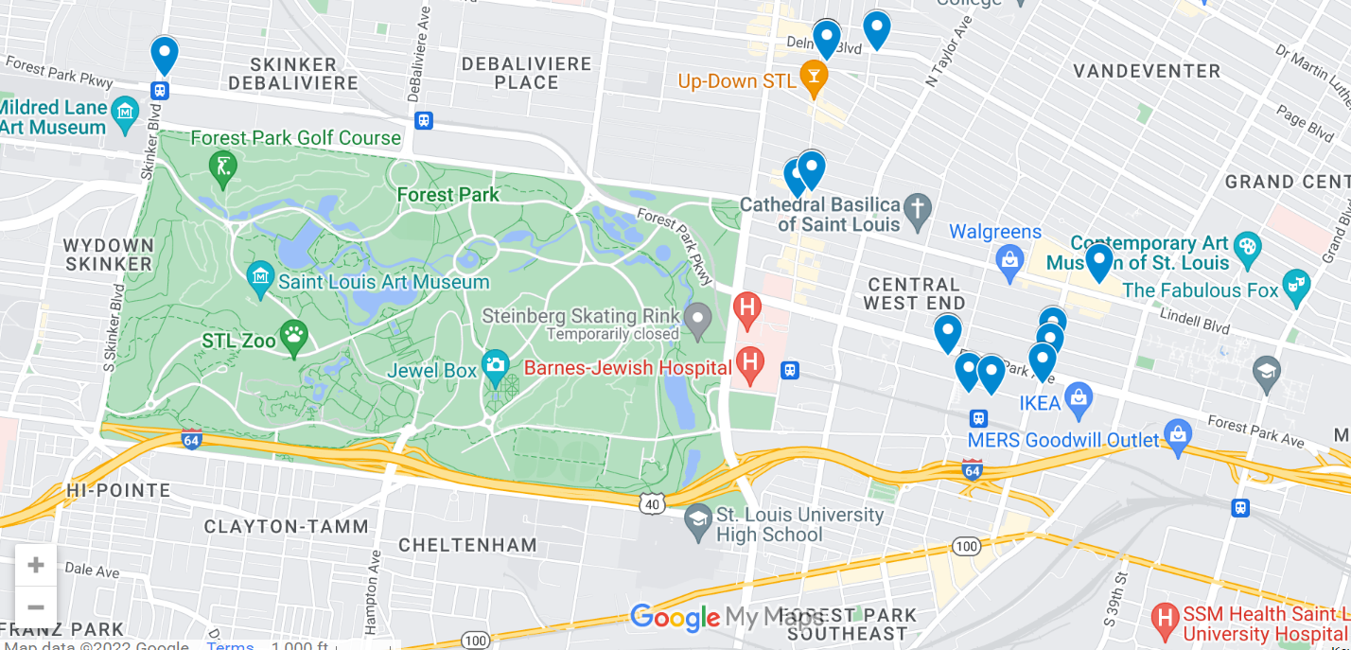
Maps – All Engagements

Slide 15
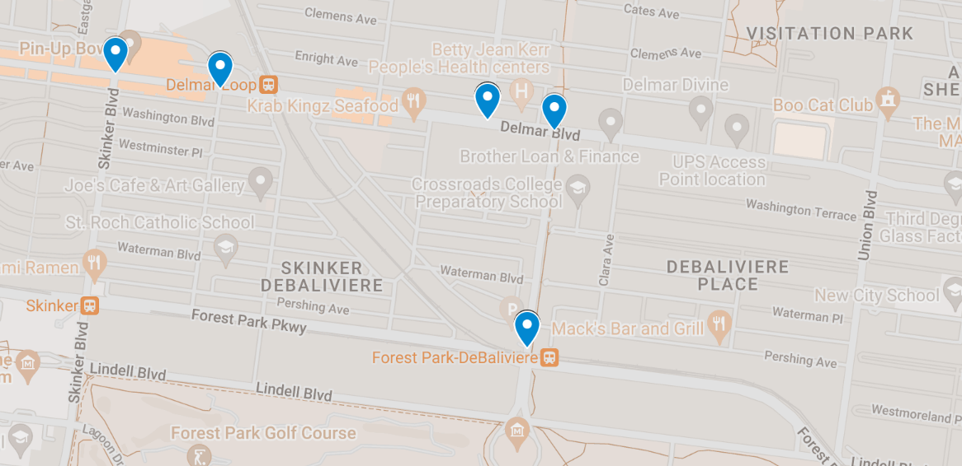
Maps – East Loop, DeBaliviere Place

Slide 16
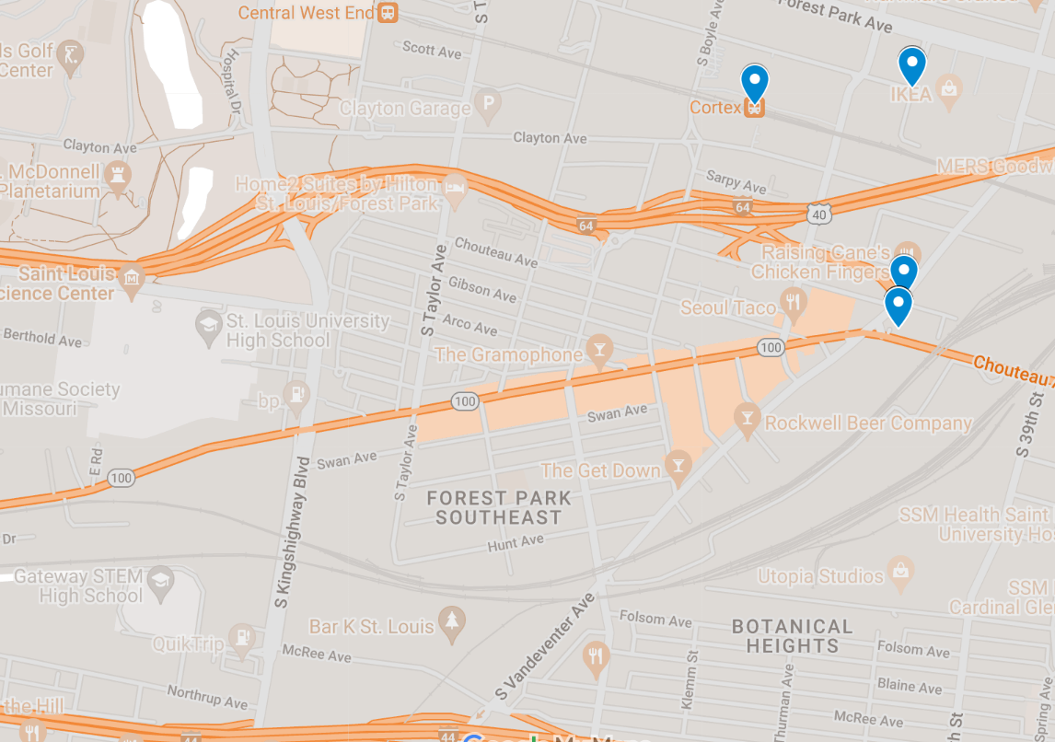
Maps – FPSE

Slide 17
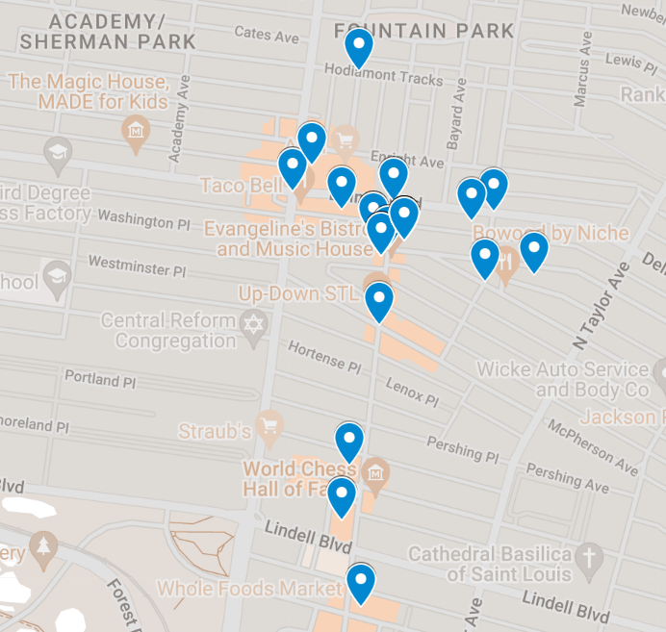
Maps – Northern Area

Slide 18
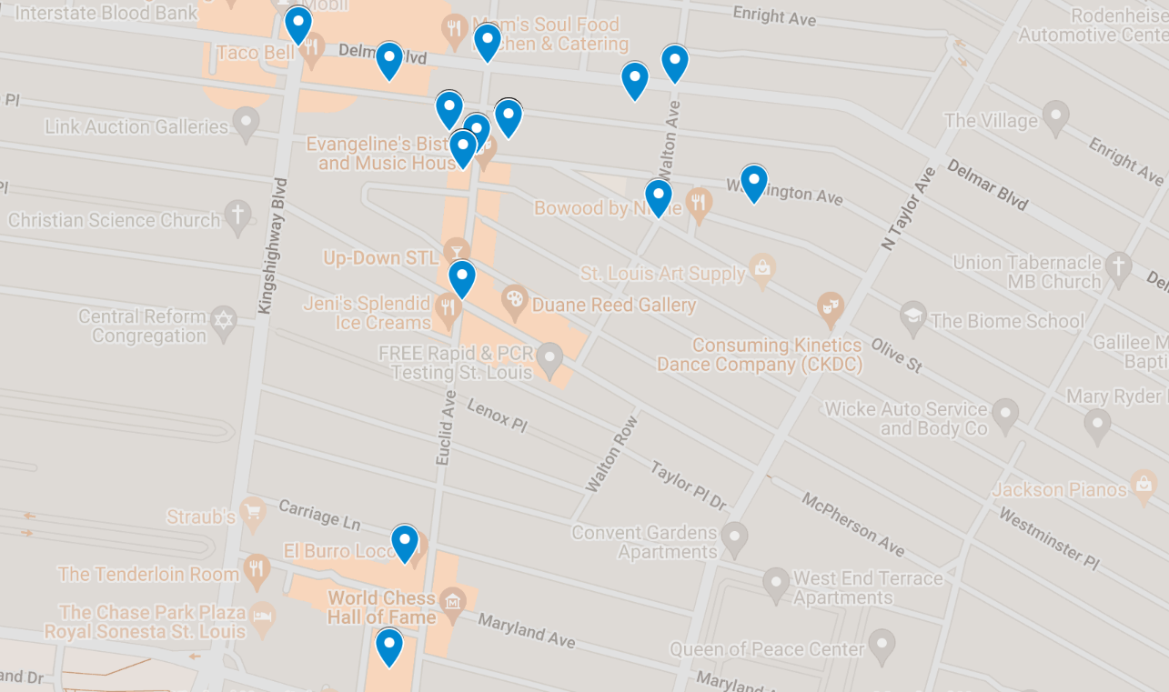
Maps – CWE North SBD

Slide 19
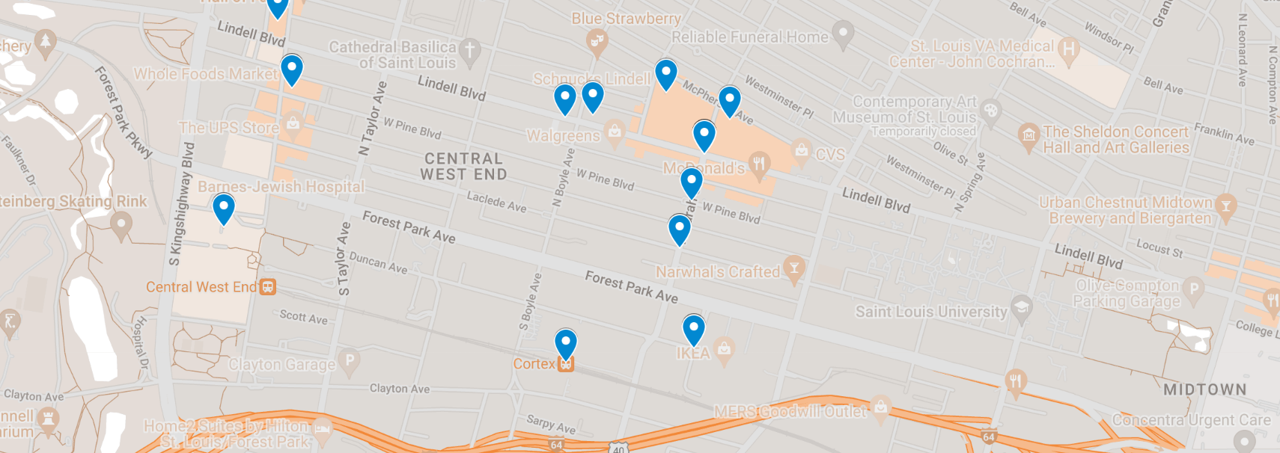
Maps – CWE Southeast SBD, Cortex

Slide 20
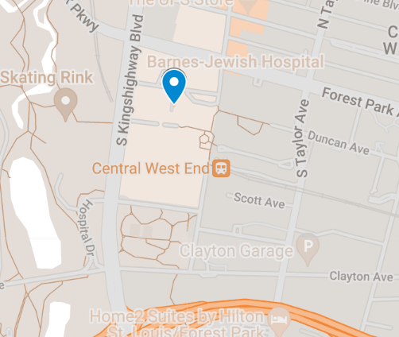
Maps – Medical Campus

Slide 21
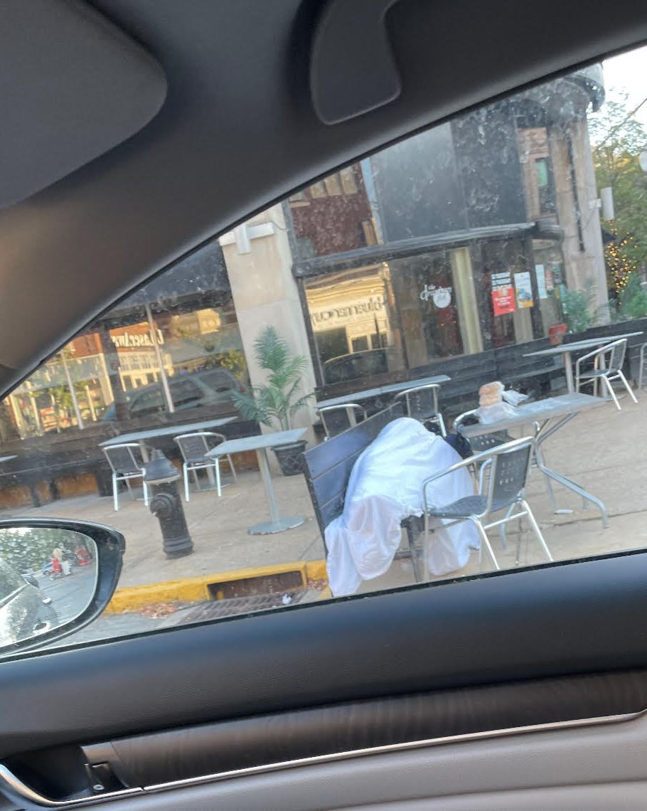
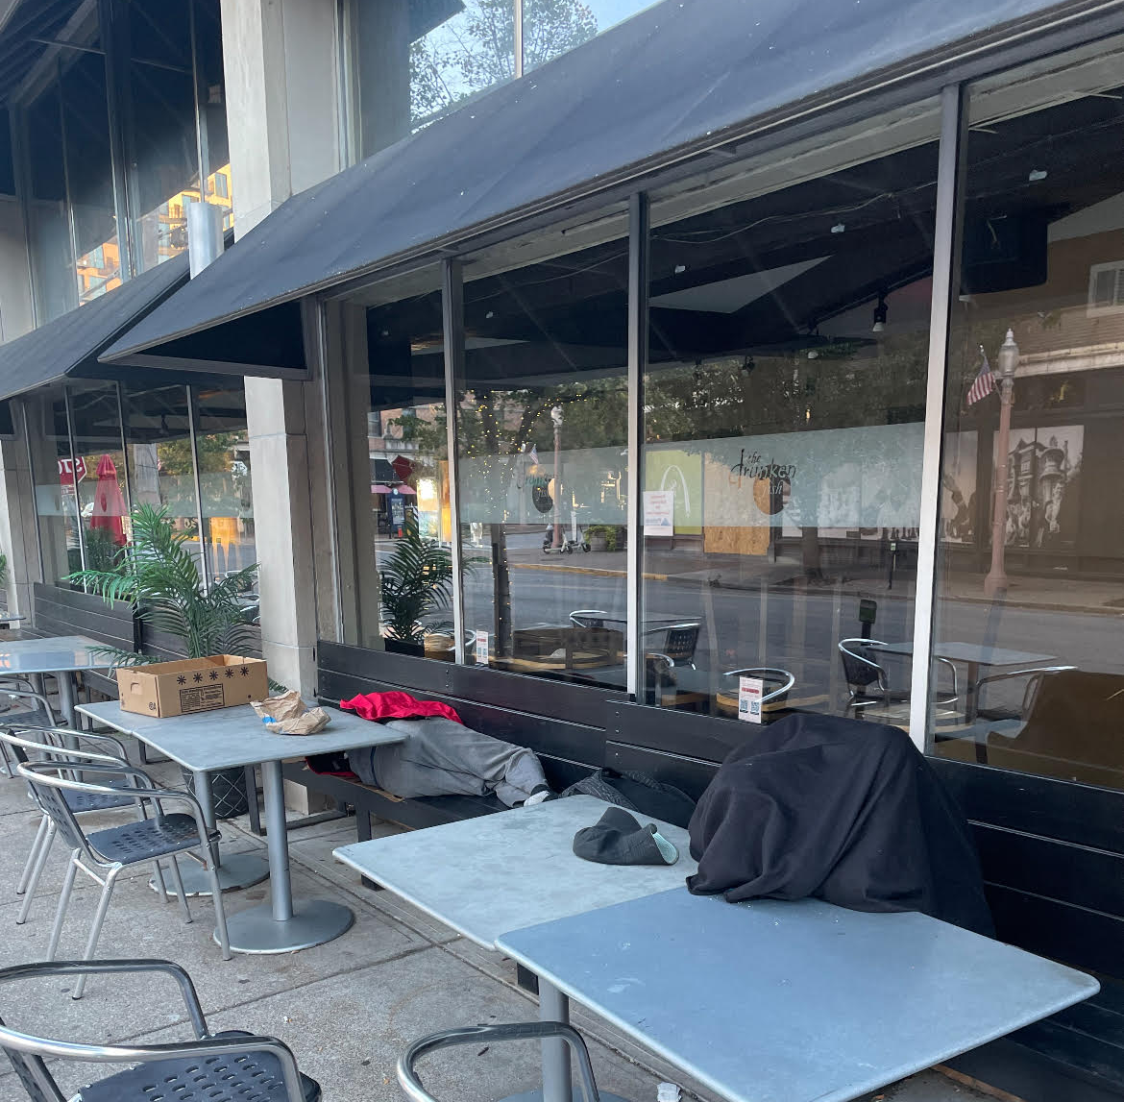
Community Interaction
We received an email from the community concerning unhoused sleeping at Euclid and Maryland overnight/early morning hours. Outreach was able to connect with these individuals. We have a good relationship with both men sleeping at the businesses and Al was able to get them to move with no problems. Between our efforts combined with TCF this problem should be taken care of.

Slide 22
Chestnut Healthcare
Substance use treatment and prevention
Mental health tx and housing for persons with mental illness
Primary care treatment and Outreach services
AL and I have connected with the outreach worker for Chestnut and they have a program with the metrolink where the outreach worker rides the bus system and connects with unhoused on the bus routes. Upon doing this they have connected with Biddle House and because of the good relationship Al has built with the outreach we now have access to beds at Biddle house anytime needed. They have set aside beds to access upon immediate need. This connection will allow Al and I to get people in shelter when needed.

