Slide 1
NSI Board Report
CWE NSI Board Meeting
October 2024
Prepared By: Sarah Wickenhauser

Slide 2
Agenda
Call to order
Meeting Minutes approval – vote
Financial Report – vote
2025 Funding
NSI Staff Reports

Slide 3
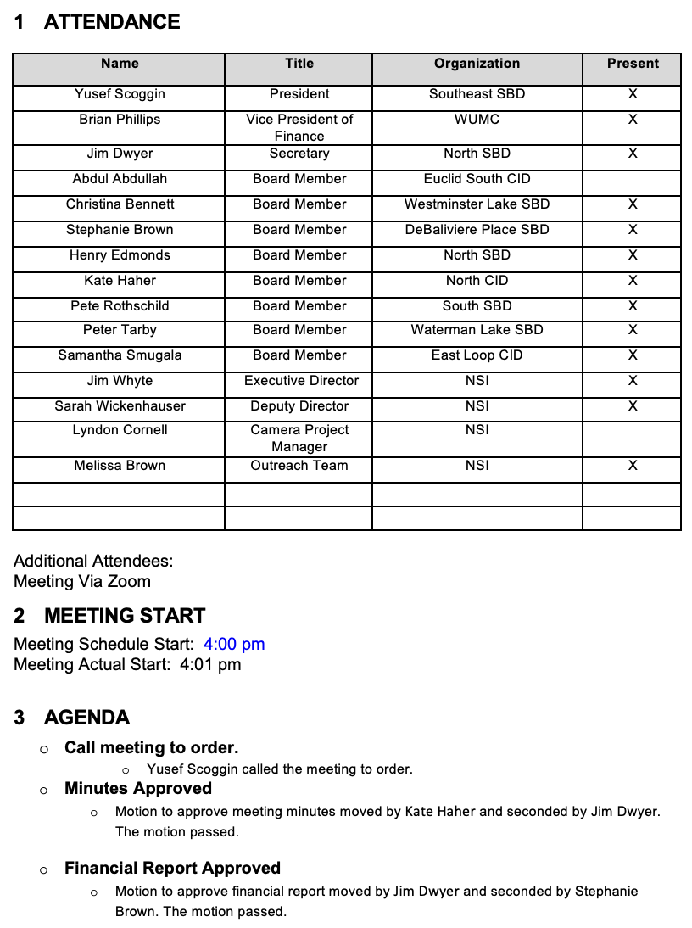
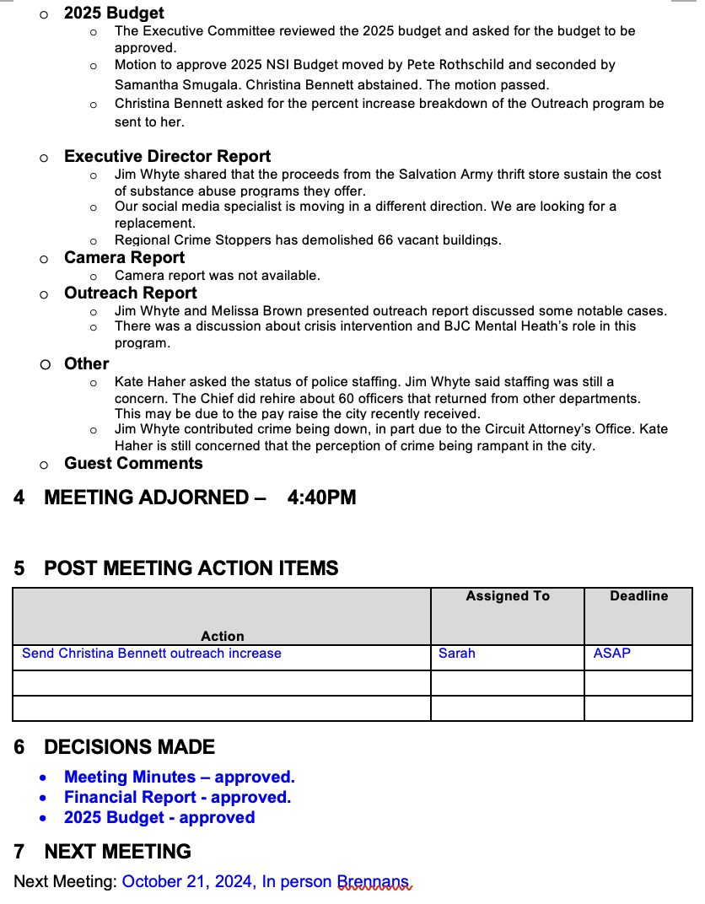
Meeting Minutes – September 2024

Slide 4
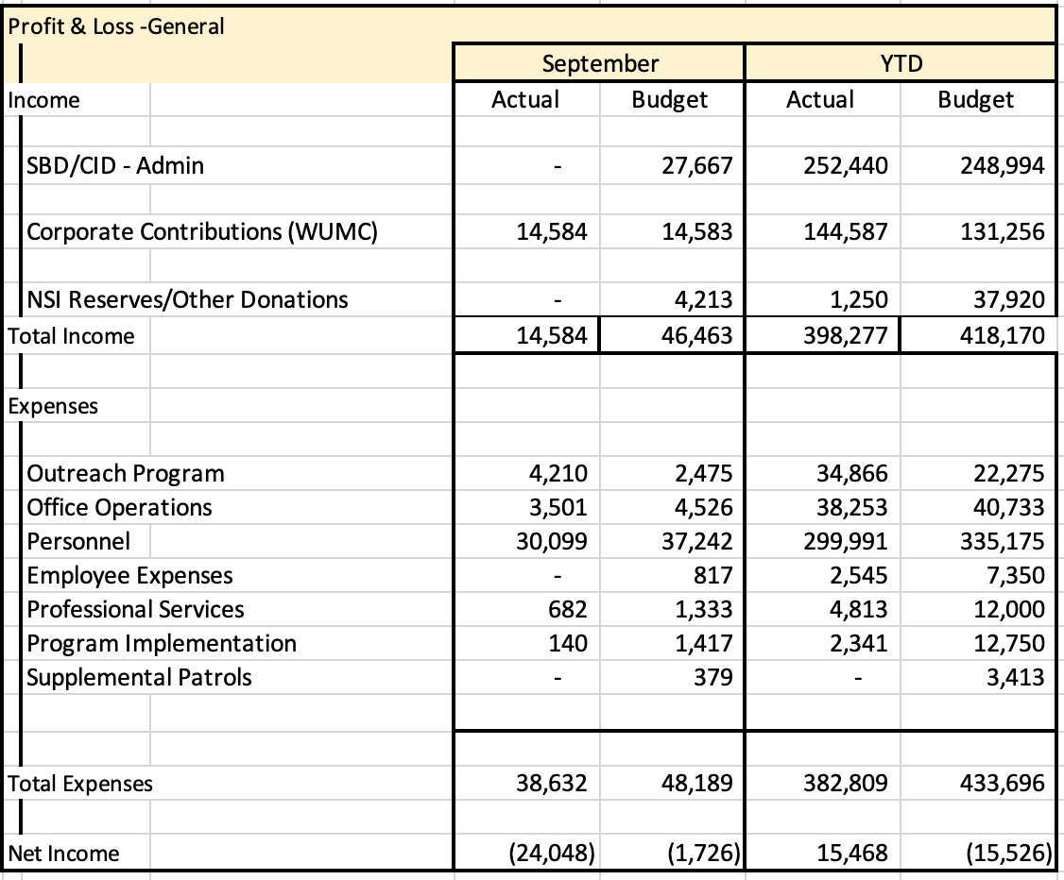
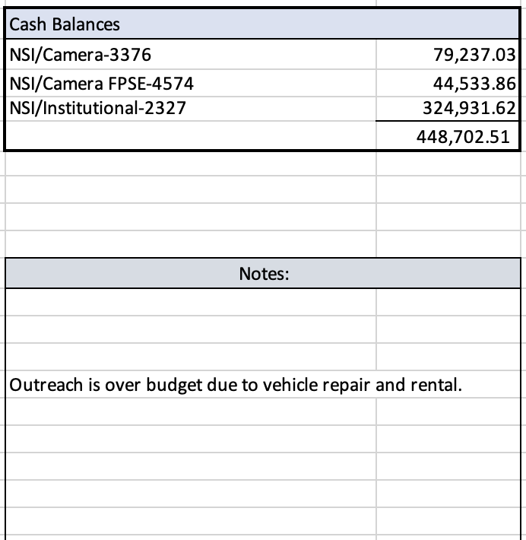
Financial Report – September 2024
Fourth quarter invoice have been sent out.

Slide 5
2025 Funding
In years past we have used SBD’s projected revenue that comes out in November. This makes it difficult to assess the participating SBD’s contribution prior to the NSI budget approval process and SBD budget due date. Another concern has been the amount collected does not always match the projected revenue. We can address these concerns by using Collector of Revenue’s report of payments from their fiscal year.
The next slide will show the amount The Collector’s office has reported for each participating district and the 2025 contributions.
The NSI Administrative Budget for 2025 is $620,000. This model uses $75,000 of NSI reserves and 14.25% of the Collector of Revenue’s report of payments from the collection period March 1, 2023 - March 4th, 2024, which is their fiscal year. The allocation of camera budget of $74,500 is calculated according to the number of camera sites within each district.

Slide 7
Reports
Executive Director Report
Camera Report
Outreach Report

Slide 8

CWE NSI
Executive Director Report
October 2024
Jim Whyte
The Central West End Neighborhood Security Initiative
447 N. Euclid Ave, St. Louis, MO 63108
jwhyte@cwensi.com
314.454.5808

Slide 9
Updates
SLMPD rolling out new Crime mapping products through their web site. https://slmpd.org/mapping/
Melissa Brown is taking over as the NSI Outreach Director beginning November 1st.
Alto-US https://www.alto.us/ , Protecting retailers, empowering communities. I met with two local employees of this global company to discuss services.
We attended a demo day at the headquarters of Utilitra, https://www.utilitra.com/. We saw many new camera applications and technology.

Slide 10


Slide 11

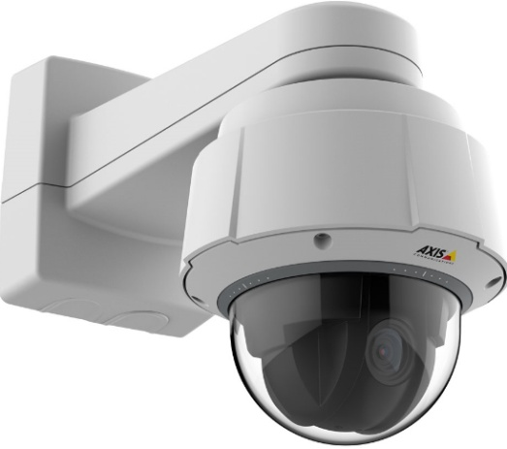
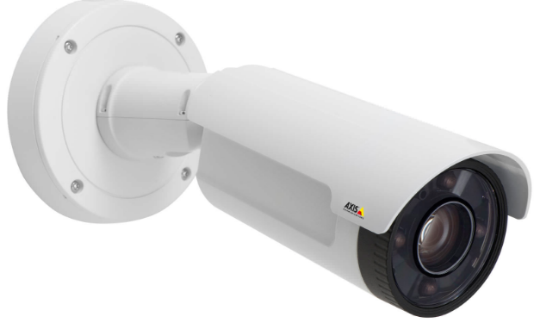
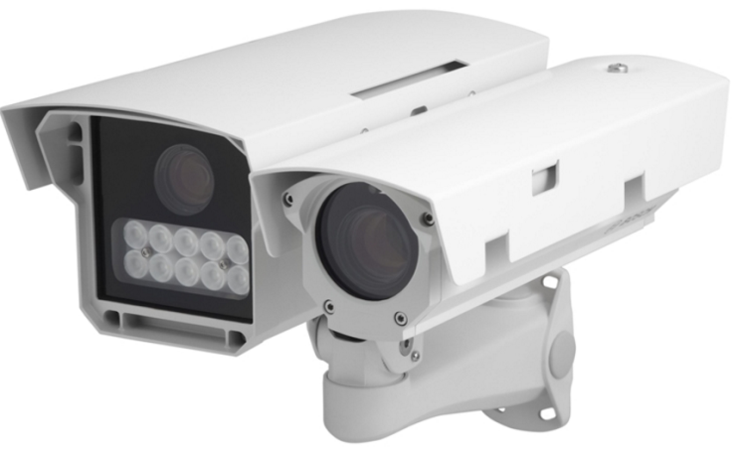
NSI Camera Project
October 21, 2024

Slide 12

Camera Management Information:
The Central West End neighborhood has 31 camera sites with 206 cameras having 366 views and 1 Flock camera.
DeBaliviere has 6 sites with 40 cameras having 68 camera views.
FPSE has 15 sites with 75 cameras having 171 camera views and 4 Flock cameras.
Loop East: (2) Camera sites with 10 cameras with 26 camera views.
Total Number of Camera Sites: 54
Total Number of Cameras: 327
Total Number of Camera Views: 618
Total Number of Flock Cameras: 5

Slide 13
Camera Review Information
From January 1, 2024 to October 21, 2024
Total camera reviews: 133
Total arrests relative to reviews: 35
Total wanted(s): 3
Total vehicle wanted(s):

Slide 14
Pending Projects
398 N. Euclid- Establish a new camera site at this location. (Complete)
625 N. Euclid- Establish New site. Complete
4500 Olive- Establish a new camera site. Complete.
4818 Olive- Camera system upgrade. Approved.
400 N. Euclid- Establish a new camera site.
405 N. Euclid- Camera system upgrade. Approved.
4701 McPherson- Camera system Upgrade. Approved.

Slide 15
Pending Camera Projects
4255 West Pine (Rejis)- Upgrade external cameras on building and install pole at intersection- On Hold.
Recommendation for Camera upgrades and establish new sites in the CWE South SBD and Euclid South CID. (Complete)
#18 N. Kingshighway- Site Survey
#40 N. Kingshighway- Site Survey
286 DeBaliviere- The camera system at this location is in need of an overhaul. The system was installed over 6 years ago. Cameras are Dahua & are not NDAA compliant (NDAA (National Defense Authorization Act. Recommend system upgrade. The NVR is currently malfunctioning and only has 4TB of storage. End of Life for equipment is 5-7 years. Schedule a site visit with camera vendor and electrician. Present proposal to SBD.
In March 2021, the Federal Communications Commission (FCC) concluded that Dahua and four other Chinese peers -- the same companies as on the 2019 NDAA list -- "pose an unacceptable risk to U.S. national security or the security and safety of U.S. persons.“

Slide 16
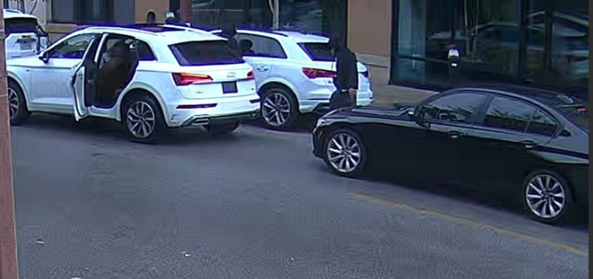
24-040665 Stealing Firearm from a MV from Euclid & Lindell on 9/22/2024 at 10:20 am
On Sunday, September 22, 2024, at around 12:04 pm, TCF patrol was in patrolling the area of Central West End North when he was flagged down by two female that wanted to report a vehicle break-in.
This incident occurred between 10:00 am and 10:50 am.
The vehicle was described as being a white in color Audi, which was parked on the east side of the roadway about four parking spots on Euclid Avenue, just north of Lindell Boulevard.
The driver’s side window was broken and a handgun was taken. The handgun was located between the driver’s seat and the center console.
The handgun was described as a black in color, Taurus GC3.
A review of the cameras in the area located the incident.

Slide 17
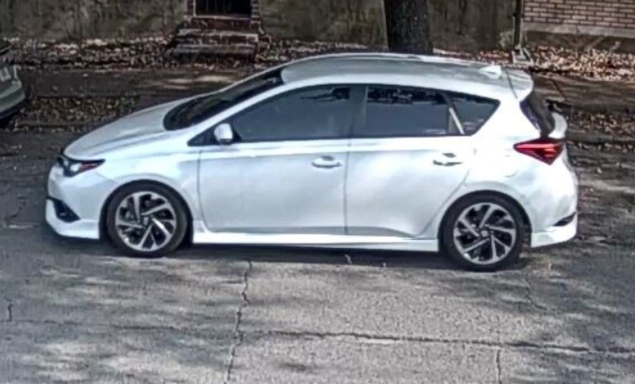
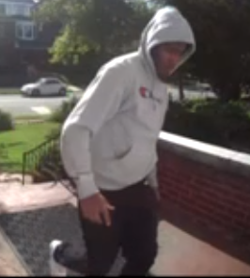
24-042365 Theft of a Package from 4707 Westminster on 9/26/2024 at 2:54 pm
A resident contacted the NSI relative to a package being stolen from the front porch of their residence.
The package contained an IPhone.
A review of the cameras in the area revealed the suspect and vehicle.
The vehicle that he was occupying was a white Toyota Scion license plate TK9-T4K being driven by a female.
This incident appears to be a trend.

Slide 18
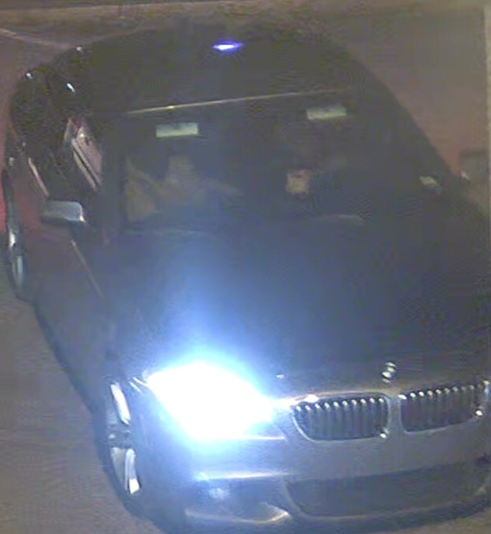
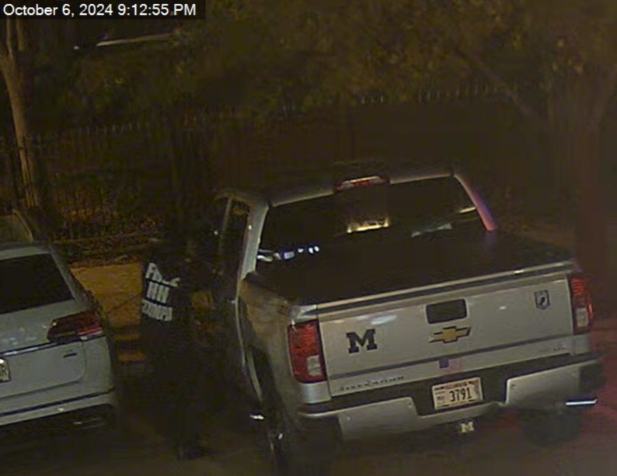
24-042451 Theft of Firearm from Motor Vehicle
#49 Maryland Plaza on 10/06/2024 at 9:12pm
NSI conducted a review of cameras in the Maryland Plaza area relative to cars break-ins and a theft of a firearm from a pick-up truck.
Suspects arrived in the area operating a BMW, 4-dr, sedan, dark grey in color, no plates.
Suspects broke into the victims Chevy Silverado pick-up and stole a firearm.
The same suspects were also seen on camera breaking into cars at 5622 Delmar, Delmonte Apartments.
One of the suspects was wearing a black hoodie with “Free HH Stumper” which may be a reference to the Hot Head gang and “Stumper” who is in-custody.

Slide 19


NSI Outreach:
Sept-October
2024 Update
Alvin Ferguson & Melissa Brown

Slide 20
61 Total Individual Engagements between June-July 2024

Slide 21
Locations of CWE NSI Outreach Engagements between
June-July 2024:

Slide 22
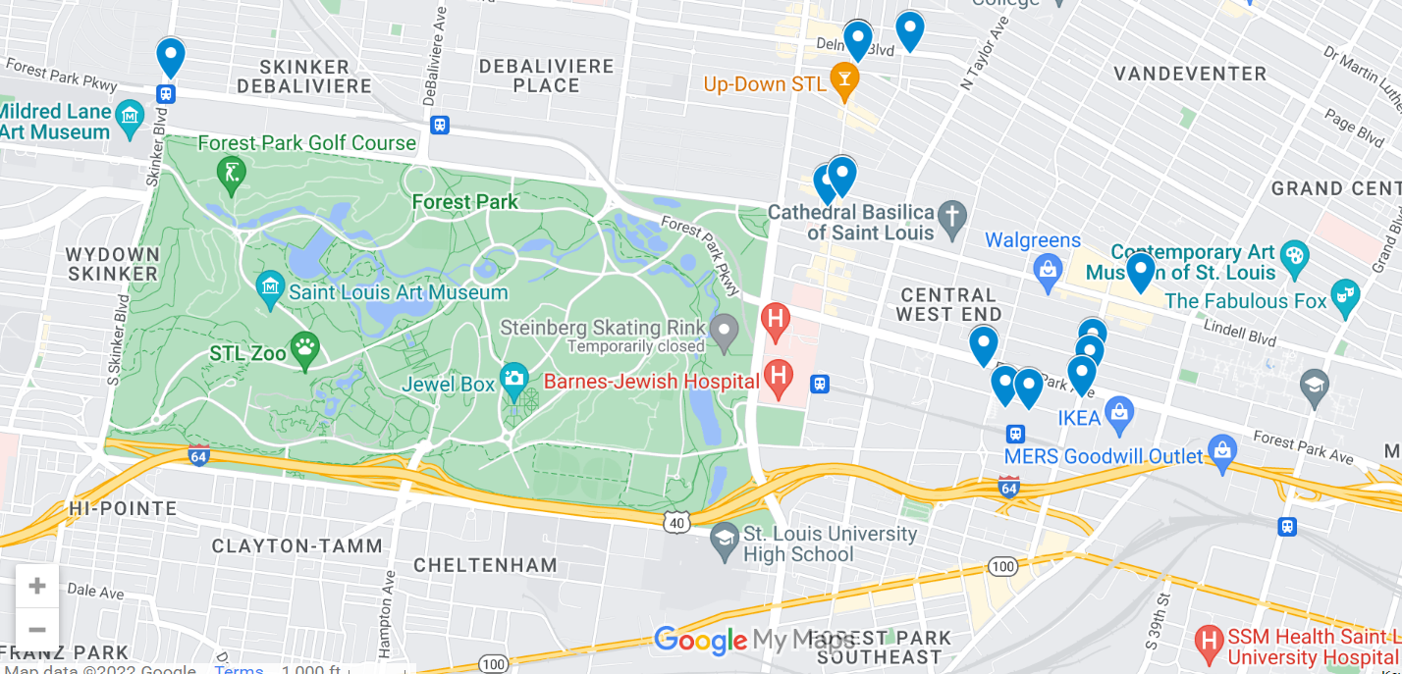
Maps – All Engagements

Slide 23
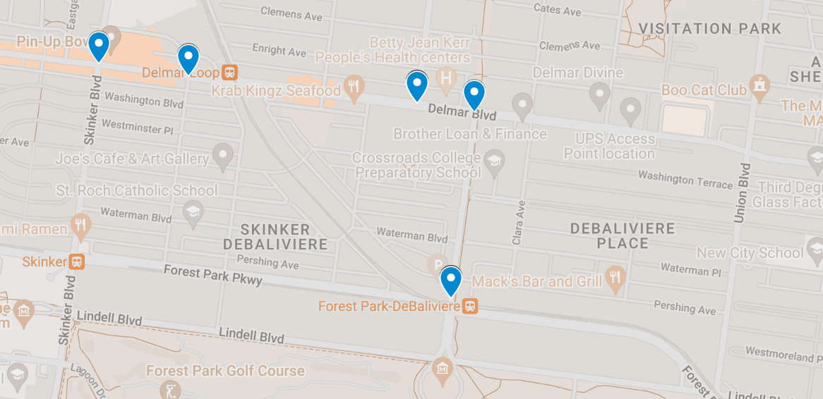
Maps – East Loop, DeBaliviere Place

Slide 24
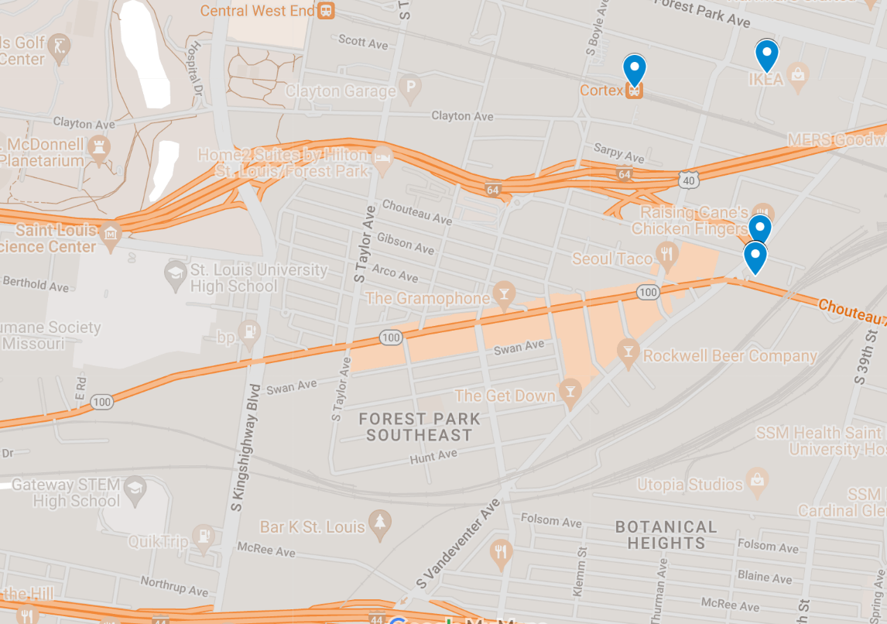
Maps – FPSE

Slide 25
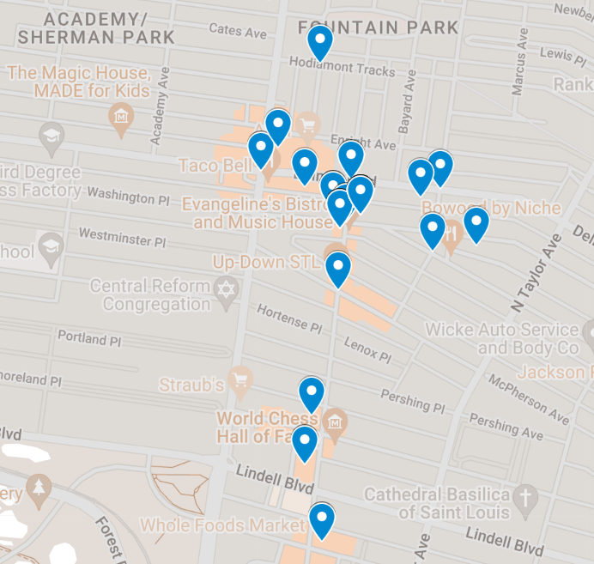
Maps – Northern Area

Slide 26
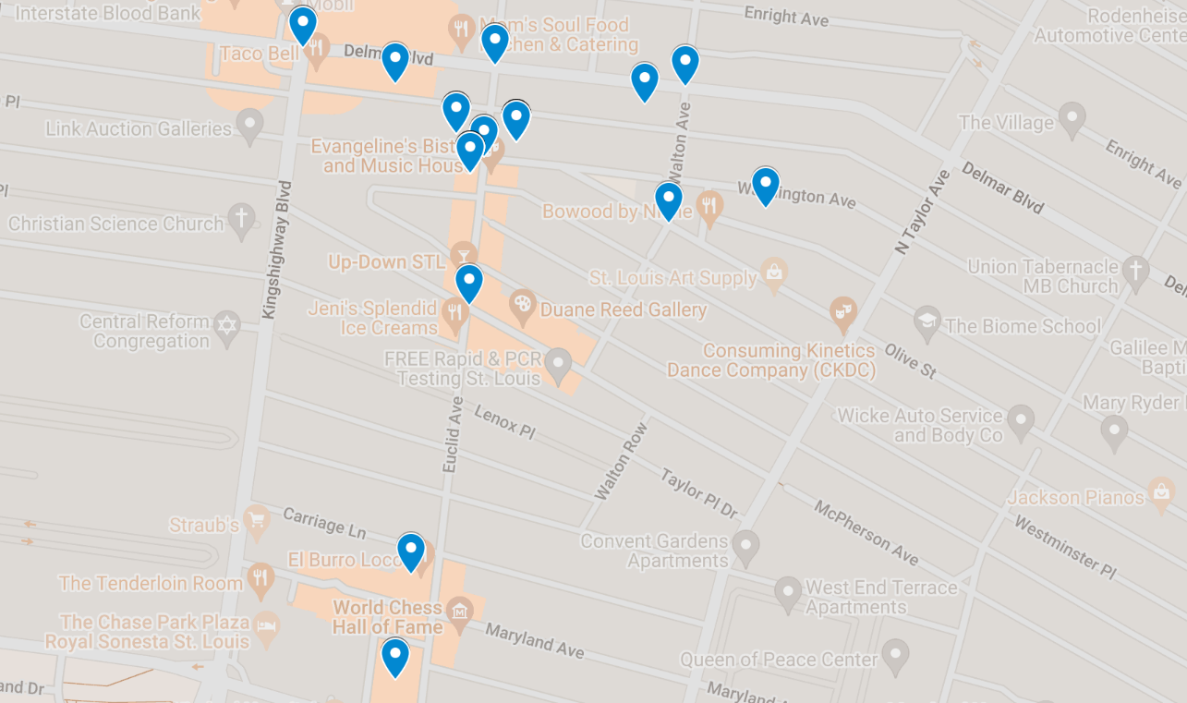
Maps – CWE North SBD

Slide 27
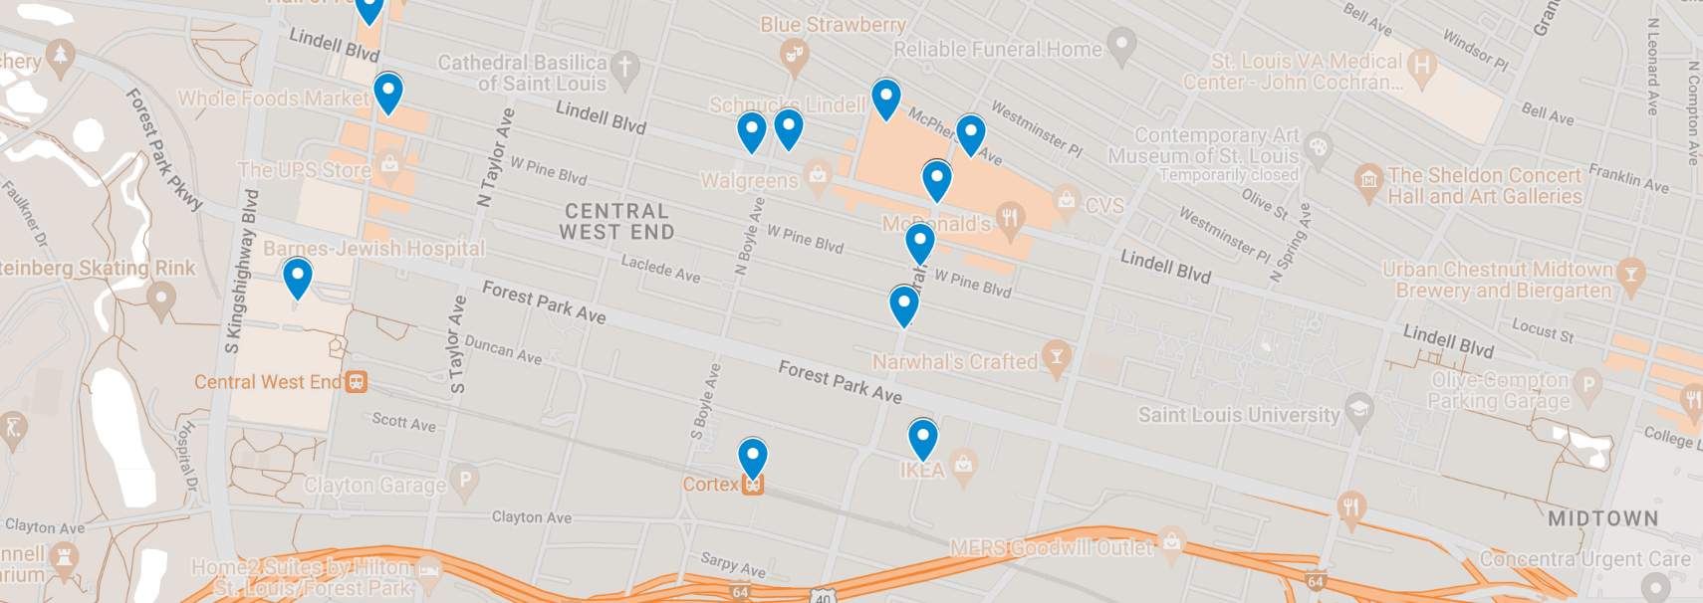
Maps – CWE Southeast SBD, Cortex

Slide 28
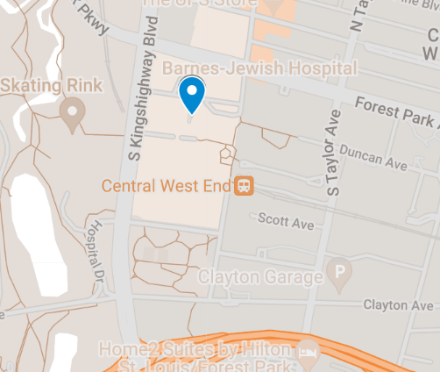
Maps – Medical Campus

Slide 29
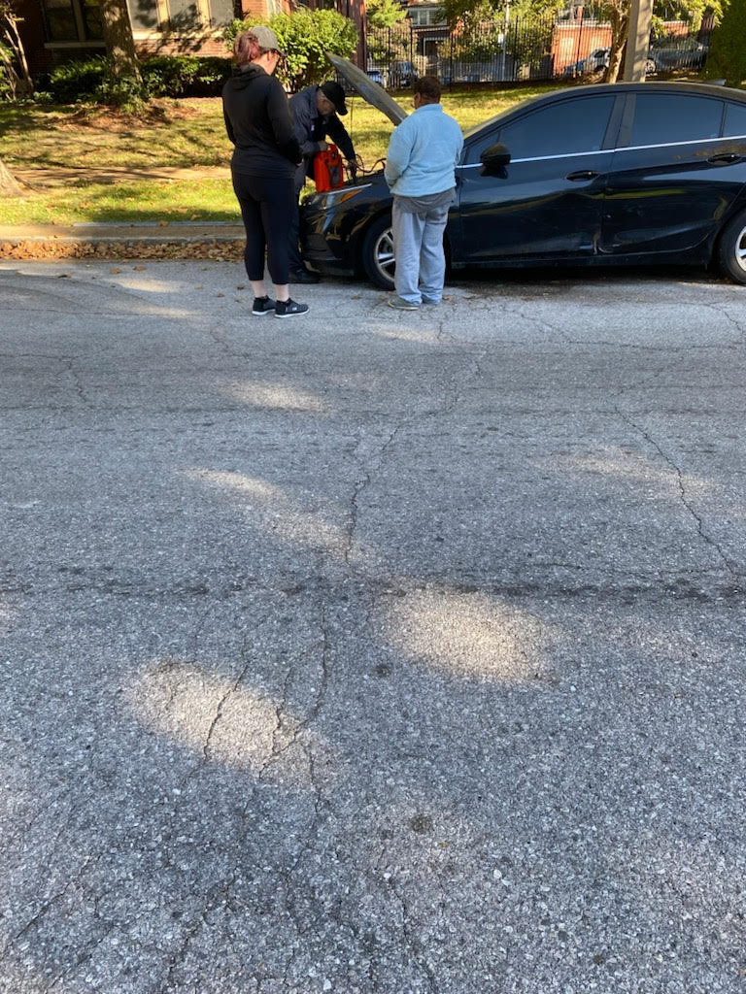
Community interaction
This car has been parked at 5600 waterman for several months. The woman in the photo has been sleeping in the vehicle. It has taken us over a month of continuous interaction before she opened up and told me her name and the fact her car is stuck because her battery needed a jump. She presents very paranoid behaviors. With the help of jim we were able to get a mechanic out to jump her vehicle. Unfortunate she did not mention losing her key faub. The next step is to assist her further to get this vehicle running. We were made known of her due to neighbors calling.

Slide 30

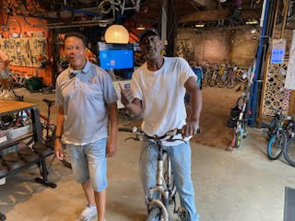




Outreach and Jim were able to provide a new bike for a gentleman we have worked with for several months. He was struggling getting to the churches for food, and to doctors appt. He expressed a bike would be a tremendous help. Jim allowed us to take him and purchase a new bicycle. He was extremely thankful. This was a major blessing and has helped him to survive daily.

