Slide 1
NSI Board Report
CWE NSI Board Meeting
August 2024
Prepared By: Sarah Wickenhauser

Slide 2
Agenda
Call to order
Meeting Minutes approval – vote
Financial Report – vote
NSI Staff Reports
Simple IRA proposal
Introduce new board members
Peter Tarby with Waterman Lake SBD
Samantha Smugala with East Loop CID

Slide 3
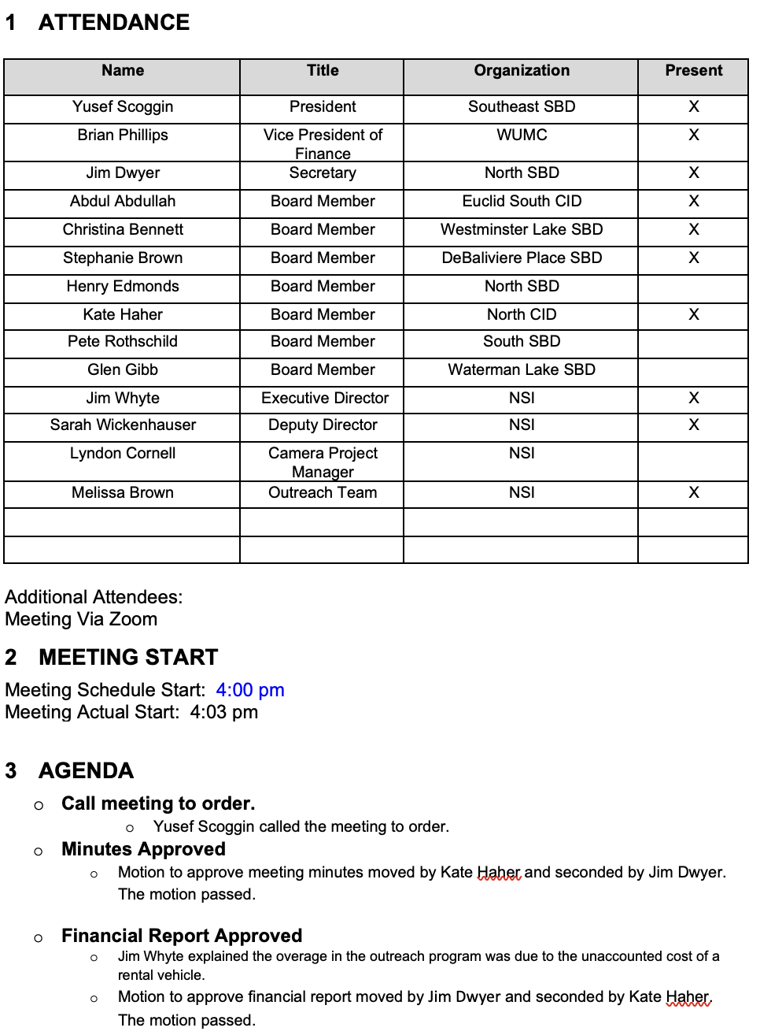
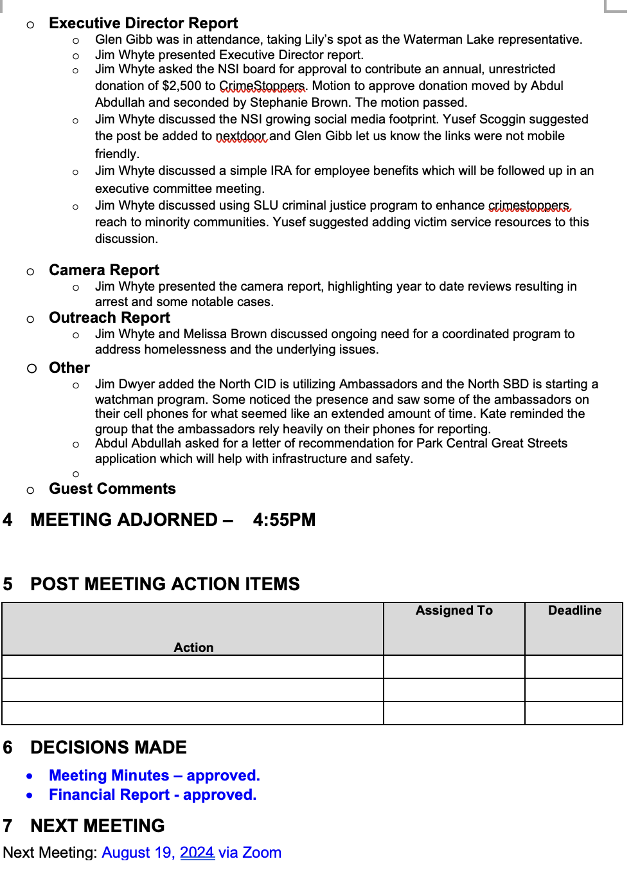
Meeting Minutes – July 2024

Slide 4
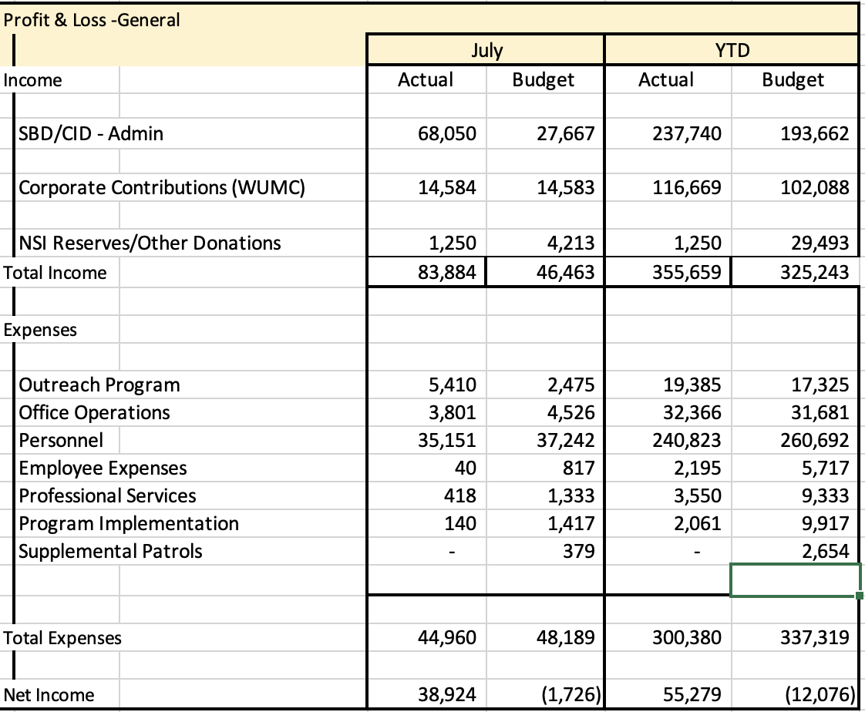
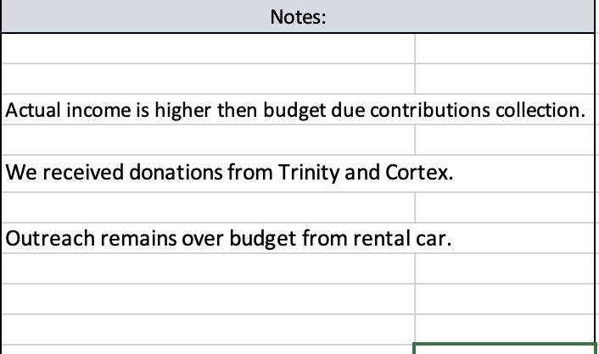
Financial Report – July 2024
We will schedule a meeting with the Executive Committee to present a draft 2025 budget in September.

Slide 5
Reports
Executive Director Report – Simple IRA proposal
Camera Report
Outreach Report

Slide 6
Simple IRA
NSI staff met with the Executive Committee to discuss a Simple IRA employee package. They were in favor of adopting this employee benefit. We would now ask for approval from the board.
West End Advisory Group simple IRA for employees.
There is a $25 annual fee per employee.
There are 2 options to participate. Employers may contribute either a flat 2% of your pay, regardless of whether you contribute, or match dollar-for-dollar what you contribute, up to 3% of your pay.
The flat 2% rate would cost the NSI $7,000.
The match dollar-for-dollar up to 3% of your pay would not exceed $11,000.

Slide 7
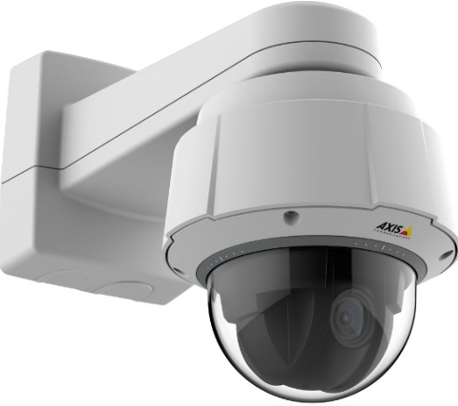
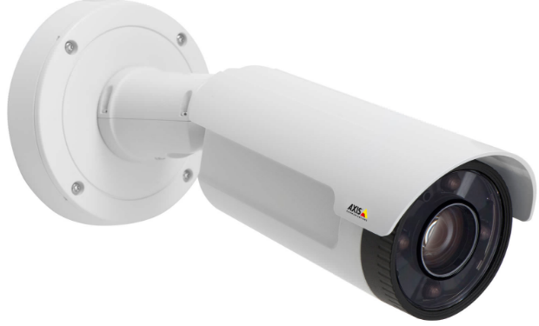
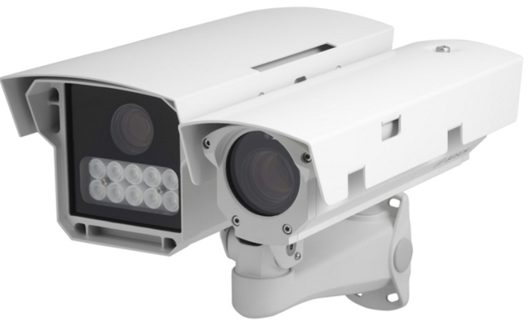
NSI Camera Project
August 19, 2024

Slide 8
Camera Management Information:
The Central West End neighborhood has 31 camera sites with 206 cameras having 366 views and 1 Flock camera.
DeBaliviere has 6 sites with 40 cameras having 68 camera views.
FPSE has 15 sites with 75 cameras having 171 camera views and 4 Flock cameras.
Loop East: (2) Camera sites with 10 cameras with 26 camera views.
Total Number of Camera Sites: 54
Total Number of Cameras: 327
Total Number of Camera Views: 618
Total Number of Flock Cameras: 5

Slide 9
Camera Review Information
From January 1, 2024 to August19, 2024
Total camera reviews: 107
Total arrests relative to reviews: 30
Total wanted(s): 3
Total vehicle wanted(s):

Slide 10
Pending Camera Projects
4255 West Pine (Rejis)- Upgrade external cameras on building and install pole at intersection- On Hold.
4321 Chouteau- Establish a new camera site. Complete
4476 Chouteau (Song Bird)- Complete.
Recommendation for Camera upgrades and establish new sites in the CWE South SBD and Euclid South CID.

Slide 11
Pending Projects continued
398 N. Euclid- Establish a new camera site at this location. (Conduit and wiring installed)
625 N. Euclid- Establish New site. Complete
4500 Olive- Establish a new camera site. Complete.
4818 Olive- Camera system upgrade.
400 N. Euclid- Establish a new camera site.
405 N. Euclid- Camera system upgrade.
4701 McPherson- Camera system Upgrade.

Slide 12
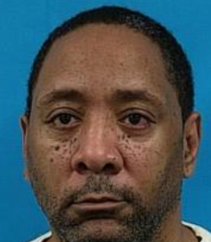
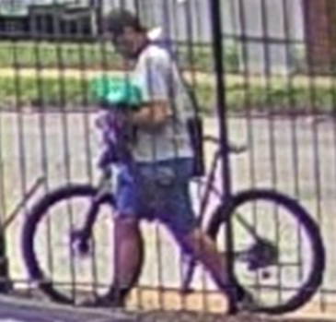
24-030803 Stealing from a Building (Bike) 4497 Pershing on 7/20/2024 at 12:17 pm
The management from Convent Gardens contacted the NSI relative to a theft of a bike.
The incident occurred between the dates of 7/19/2024- 7/21/2024.
The management was able to review the internal camera which revealed date and time that the suspect unlawfully entered the apartment building.
A review of the NSI cameras in the area revealed the suspect.
The suspect approached the front of the building, waited for an Amazon employee to exit and then he entered the building.
The suspect exit via the side door in possession of the bike. He was last seen walking east on Pershing towards Newstead.
Darwin Thomas

Slide 13
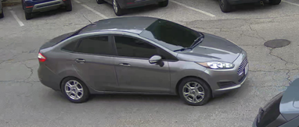
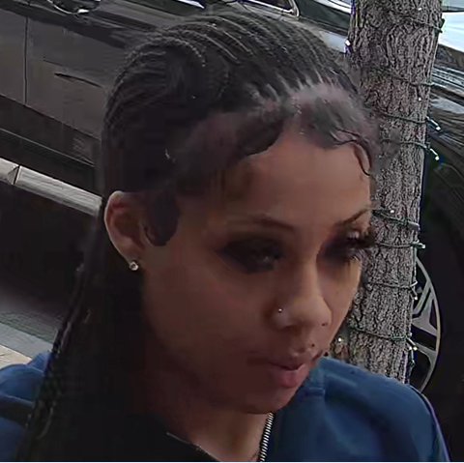
24-030636 Theft #26 Maryland Plaza (Lululemon) 07-21-2024 @1429hrs
The NSI Division was advised of the above incident, date, and time.
The NSI Division conducted a camera review and observed the suspect and suspected vehicle arrive prior to the incident and leave after.
While conducting the camera review the NSI observed the suspect, traveling north on Kingshighway and east on Maryland Plaza. The vehicle parked on the north side of Maryland Plaza across from Lululemon in front of a fire hydrant.
The vehicle is a Grey Ford compact car bearing Missouri plates of GL1 X2X occupied by 3-4 suspects/occupants, 2 are females. The windows including the windshield is heavily tinted.

Slide 14
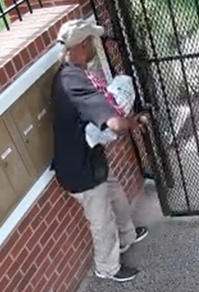
24-032234 Theft of Packages 4225 West Pine on 7/27/2024 at 10:13 am
The NSI received information relative to a Theft of Packages from 4225 West Pine.
A video review was conducted.
The suspect was observed prior to and after the theft.
This suspect stole packages from this location on numerous occasions.

Slide 15
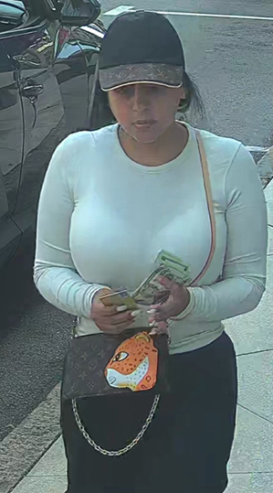
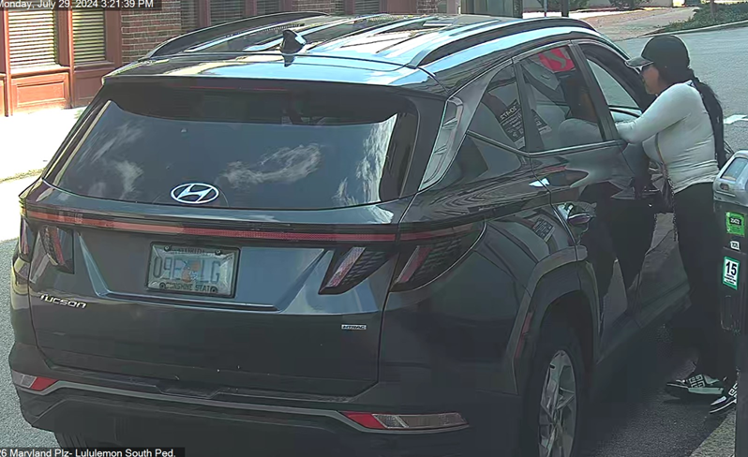
24-001737 Theft of a Credit Device Richmond Heights PD on 7/29/2024
The NSI received information relative to a Theft of a Credit Card from Richmond Height PD.
Information that was received involved a Hispanic couple with the female wearing Louis Vitton hat with a Louis Vitton cross body purse Purse and the male wearing a Coach hat.
The suspects used the stolen credit card at Lululemons located in the Central West End.
A video review was conducted at which time a couple matching the aforementioned description entered the store at approximately 3:11 pm and exited at approximately 3:34 pm.
The suspects arrived in a dark gray Hyundai Tucson being Florida license plate 09E-LG being driven by an additional a male.
These suspect are possibly part of a nationwide theft ring.

Slide 16
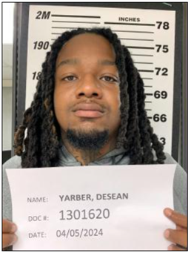
24-032956 Robbery 1st/Property Damage 1st from 4512 Manchester on 08-05-2024 at 1:15 am
Officers responded to the above location for an "Assault." Upon arrival they met victim #1 who stated that they were robbed at gun point by the suspects. The suspect stole his Apple watch, I-Phone 15, brown bag, car keys, and wallet. While the suspects were robbing the victim they also broke into victim #2's 2018 Chevy Cruze. The suspects rummaged through the vehicle; however, nothing was stolen. The suspects were last observed running west from this location, and eventually out of sight.
The NSI Division was advised of the above incident, date, and time.
The NSI Division conducted a camera review and observed the incident.
While conducting the camera review the NSI observed the suspects on the parking lot of 4512 Manchester.
It should be noted suspect #1 is possibly the same suspect in recent incidents in the FPSE neighborhood as he has been seen on cameras in the FPSE neighborhood on several dates involving other incidents.

