Slide 1
NSI Board Report
CWE NSI Board Meeting
November 2024
Prepared By: Sarah Wickenhauser

Slide 2
Agenda
Call to order
Meeting Minutes approval – vote
Financial Report – vote
NSI Staff Reports

Slide 3
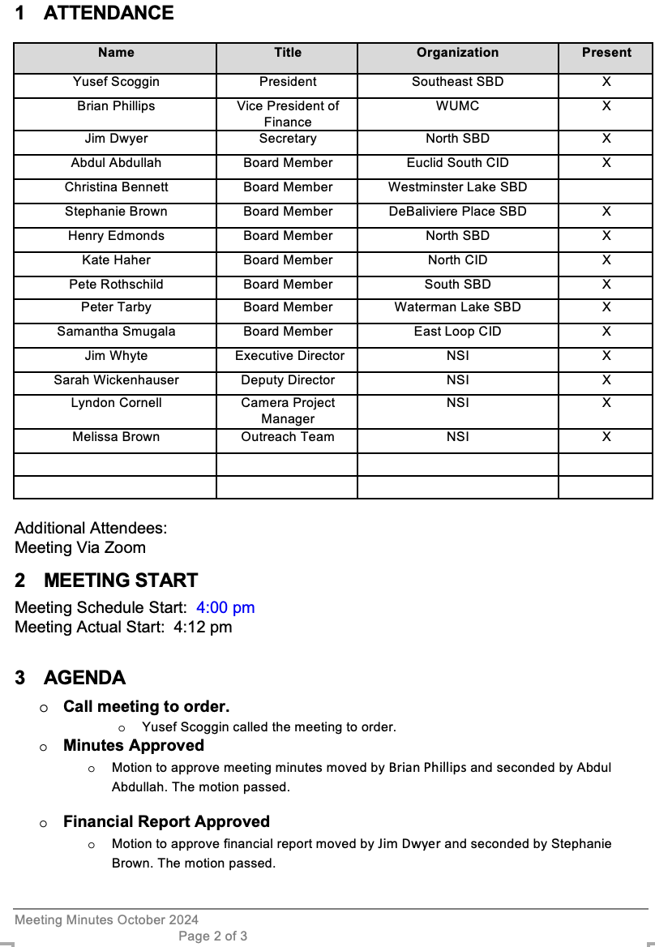
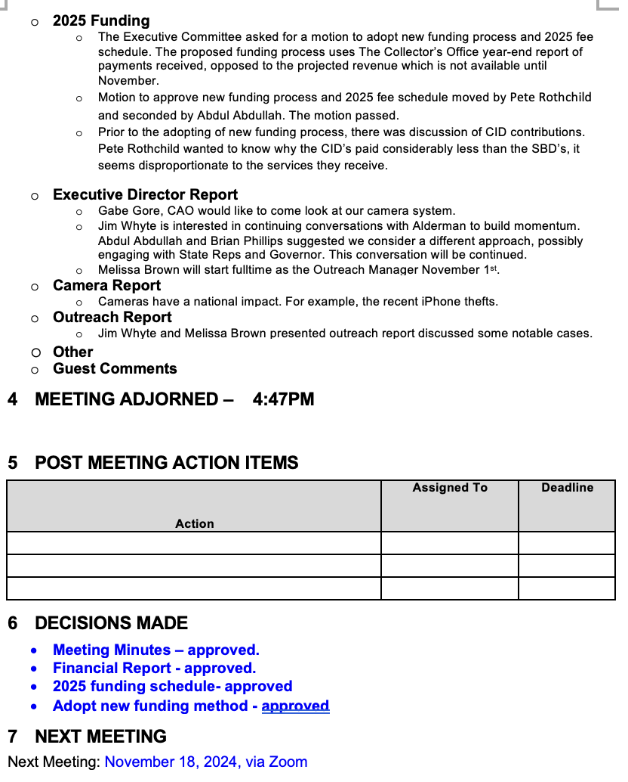
Meeting Minutes – October 2024

Slide 4
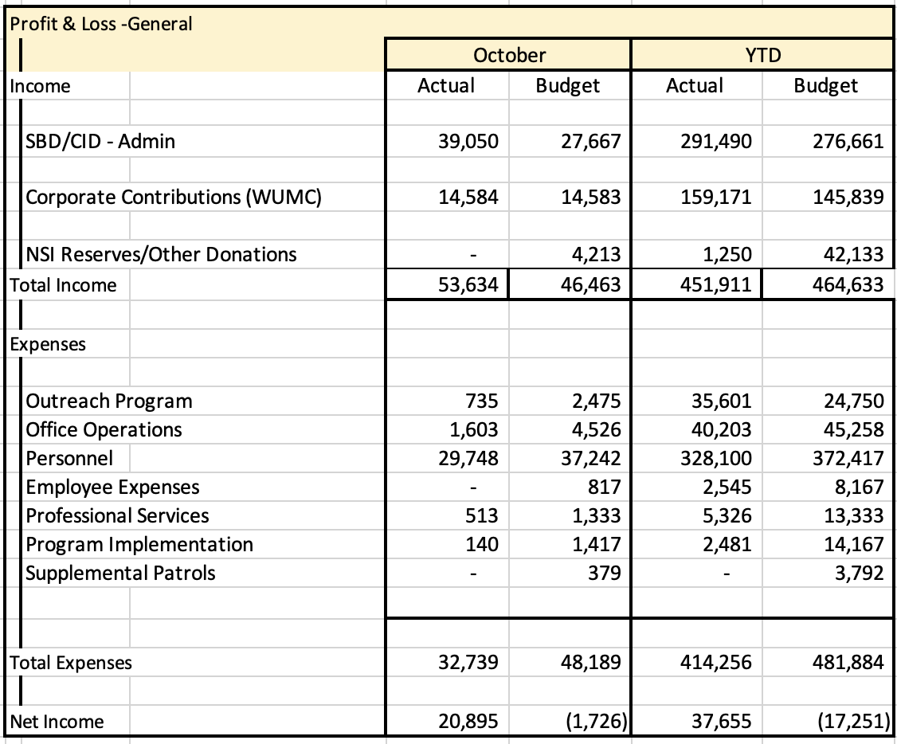
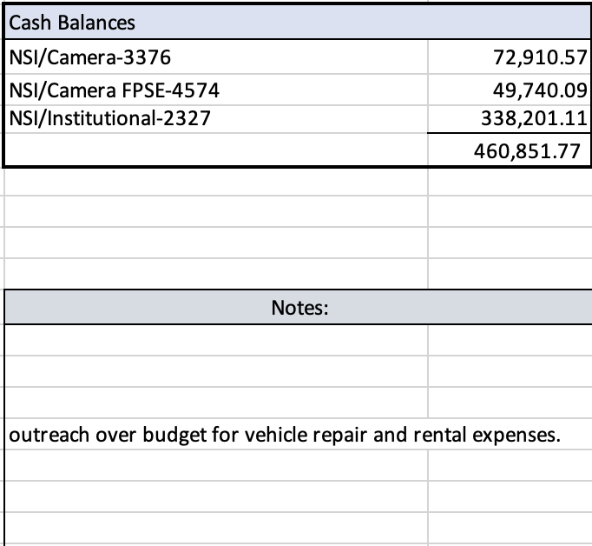
Financial Report – October 2024
Fourth quarter invoice have been sent out.

Slide 5
Reports
Executive Director Report
Camera Report
Outreach Report

Slide 6
CWE NSI Executive Director Report November 2024
Jim Whyte
The Central West End Neighborhood Security Initiative
447 N. Euclid Ave, St. Louis, MO 63108
jwhyte@cwensi.com
314.454.5808

Slide 7
Updates
SLMPD made several promotions and command assignments. Christi Marks was promoted to Major and assigned to the South Patrol Division. William T. Brown was promoted to Captain and assigned to command the 5th District. I will reach out and schedule a meeting with Captain Brown once he is acclimated to his new assignment.
NSI has been working with the Frontenac Police Department regarding thefts from the Lululemons stores in the CWE and Frontenac. Subjects responsible have been involved in theft incidents at both stores.
The NSI has made contacts with the Missouri Organized Retail Theft Association (MORCA) to offer our participation is reviving the organization.
I participated in a discussion with residents of the South Park Neighborhood Association in Los Angeles, CA. The reisdents and I discussed the NSI as an organization and our extensive security camera operation. Follow-up discussions are being scheduled.

Slide 8
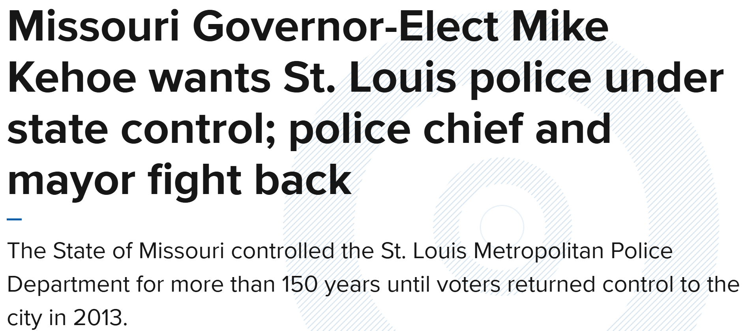

Slide 9
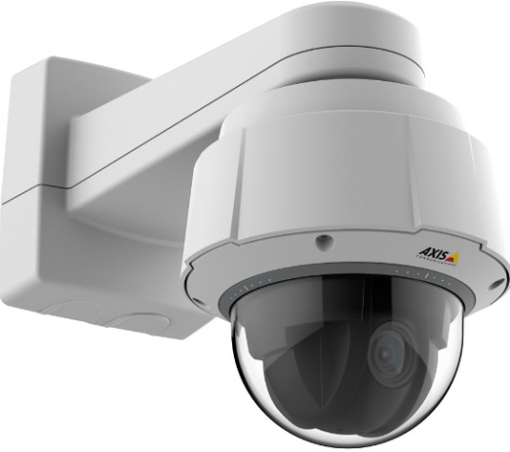
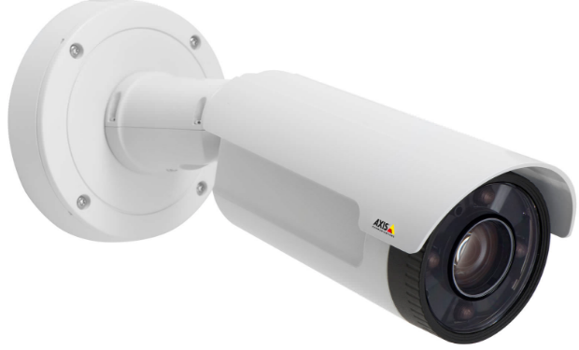
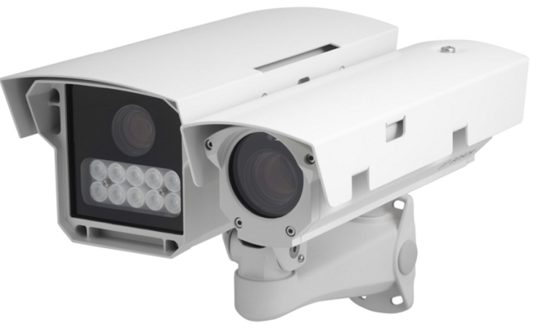
NSI Camera Project
November 18, 2024

Slide 10
Camera Management Information:
The Central West End neighborhood has 31 camera sites with 206 cameras having 366 views and 1 Flock camera.
DeBaliviere has 6 sites with 40 cameras having 68 camera views.
FPSE has 15 sites with 75 cameras having 171 camera views and 4 Flock cameras.
Loop East: (2) Camera sites with 10 cameras with 26 camera views.
Total Number of Camera Sites: 54
Total Number of Cameras: 327
Total Number of Camera Views: 618
Total Number of Flock Cameras: 5

Slide 11
Camera Review Information
From January 1, 2024 to November 18, 2024
Total camera reviews: 151
Total arrests relative to reviews: 41
Total wanted(s): 5
Total vehicle wanted(s):

Slide 12
Pending Projects
398 N. Euclid- Establish a new camera site at this location. (Complete)
625 N. Euclid- Establish New site. Complete
4500 Olive- Establish a new camera site. Complete.
4818 Olive- Camera system upgrade. In Process.
400 N. Euclid- Establish a new camera site.
405 N. Euclid- Camera system upgrade. Approved.
4701 McPherson- Camera system Upgrade. Approved.

Slide 13
Pending Camera Projects
4255 West Pine (Rejis)- Upgrade external cameras on building and install pole at intersection- On Hold.
Recommendation for Camera upgrades and establish new sites in the CWE South SBD and Euclid South CID. (Complete)
#18 N. Kingshighway- Site Survey Complete.
#40 N. Kingshighway- Site Survey Complete.
286 DeBaliviere- The camera system at this location is in need of an overhaul. The system was installed over 6 years ago. Cameras are Dahua & are not NDAA compliant (NDAA National Defense Authorization Act.) Recommend system upgrade. The NVR is currently malfunctioning and only has 4TB of storage. End of Life for equipment is 5-7 years. Schedule a site visit with camera vendor and electrician. Present proposal to SBD.
In March 2021, the Federal Communications Commission (FCC) concluded that Dahua and four other Chinese peers -- the same companies as on the 2019 NDAA list -- "pose an unacceptable risk to U.S. national security or the security and safety of U.S. persons.“

Slide 14
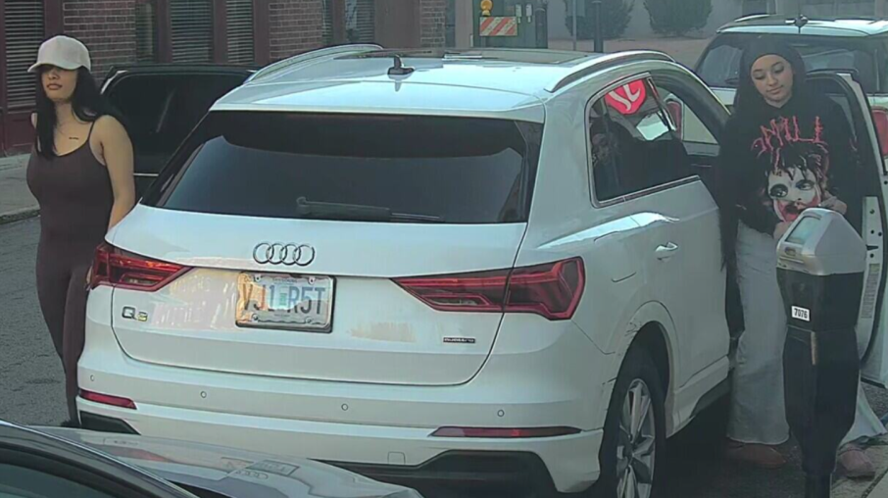
24-045573 Shoplifting Incident Lululemon 26 Maryland Plaza 10/27/2024 at 4:35pm
Lululemon manager, Mia, contacted the NSI to report a theft which had just occurred.
The suspects were seen on video leaving the store at 5:25pm with arms full of merchandise.
The suspects walked east on Maryland then south on York and entered a white Audi SUV with Missouri plate VJ1 R5T which was driven by a third subject.
The vehicle drove south on York then west on Lindell.

Slide 15
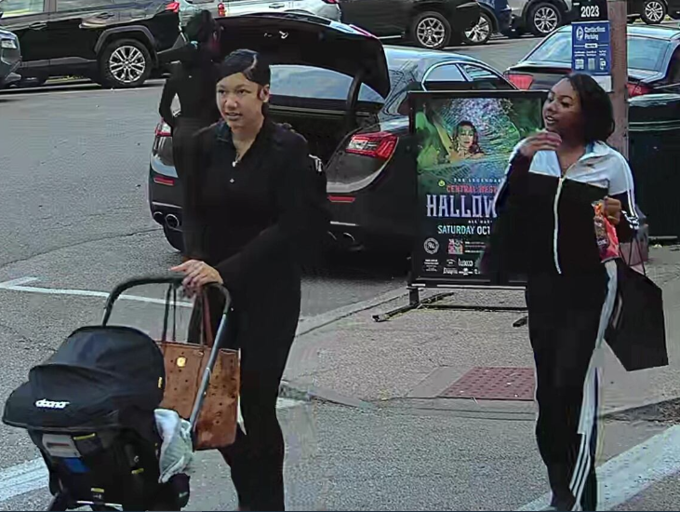
Lululemon 26 Maryland Plaza on 10/30/2024 at 5:40pm
Lululemon representative, Jenna, contacted the NSI to report a theft involving 3 subjects.
Video review shows the subjects, identified by Jenna, arriving, entering the store and leaving.
Video also captured the car operated by the subjects arriving and parking on the south side of Maryland, just east of York.

Slide 16
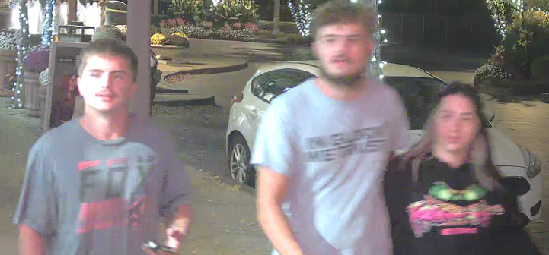
Tampering 1st #62 Maryland and Chase Drive on 10/30/2024 at 9:50 pm.
Email from the Chase Director of Loss Prevention:
Last night at 9:42pm, a white Scion pulled into resident valet drive on Maryland. They were told not to park there, and at 9:50 pulled into the loading zone right before the garage drive.
3 individuals got out and walked east on Maryland toward Euclid.
My team called to have the car towed overnight and it was discovered the vehicle is stolen. We are awaiting City PD to come recover the vehicle.
A review of the cameras in the area revealed the suspects.

Slide 17
Attempt Stealing From A Person on 11/01/2024 at 10:00PM from 319 N Taylor
The NSI Camera Division was contacted by Barbara Lutey via email.
Lutey reported she was walking home north on Taylor approaching Pershing at approximately 10:00PM when she was approached from behind and struck on her chest with an open hand by an unknown suspect who attempted to take her bag; however, was unsuccessful.
The suspect ran north on Taylor out of sight.
The NSI conducted a camera review of the NSI cameras in the area and first observed the victim walking east on Lindell, North on Taylor, and East on Pershing until she reached 4497 Pershing (Convent Garden Apartments.
The NSI observed a Black male suspect wearing a black hoodie with ST Louis Cardinals on the front, a red strip on the hood, blue jean pants, medium dark complexion, medium build, and black boots.
The suspects walked on the south side Lindell while the victim was on the north side of Lindell walking the same direction as the victim.
The suspect was observed running crossing the street at 319 Taylor behind the victim and shortly after was seen passing the victim and walking west on Pershing out of sight.
An Attempt to Identify was sent to the CWE LEO Security Group.

Slide 18
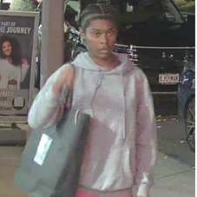
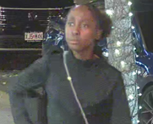
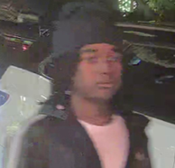
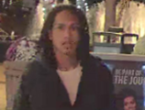
Retail Theft from Lululemons from 26 Maryland Plaza on 11/6/2024 at 6:36 pm
PO Allen contacted the NSI relative to a theft at Lululemons.
The suspects (2 males and 2 females) arrived on Maryland at 6:23 pm driving a Tesla.
All four suspects entered Lululemons carrying Saks Fifth Avenue bags.
The female in all black clothing was observed during another theft incident from this store.
The suspects exit the store running west on Maryland.
They entered their vehicle and fled north on Kingshighway at approximately 6:40 pm.

Slide 19
NSI Outreach: October-November 2024 Update
Alvin Ferguson & Melissa Brown

Slide 20
Number of People Engaged
From Oct-Nov 15th We have completed 46 engagements in the community.
Of these 46 engagements, there were 12 were repeat individuals.
40 of these individuals were men, 6 were women, and 0 person identified as transgender.
These engagements took place in the following areas:
23 in the North SBD, 3 in the South SBD, 0 in the Southeast SBD, 9 in the East Loop CID, 8 in the DeBaliviere Place SBD, 1 in the Waterman-Lake SBD, 0 on the Washington University Medical Center Campus, 2 on Cortex, 0 in the Forest Park Southeast neighborhood, and 0 outside boundaries.

Slide 21
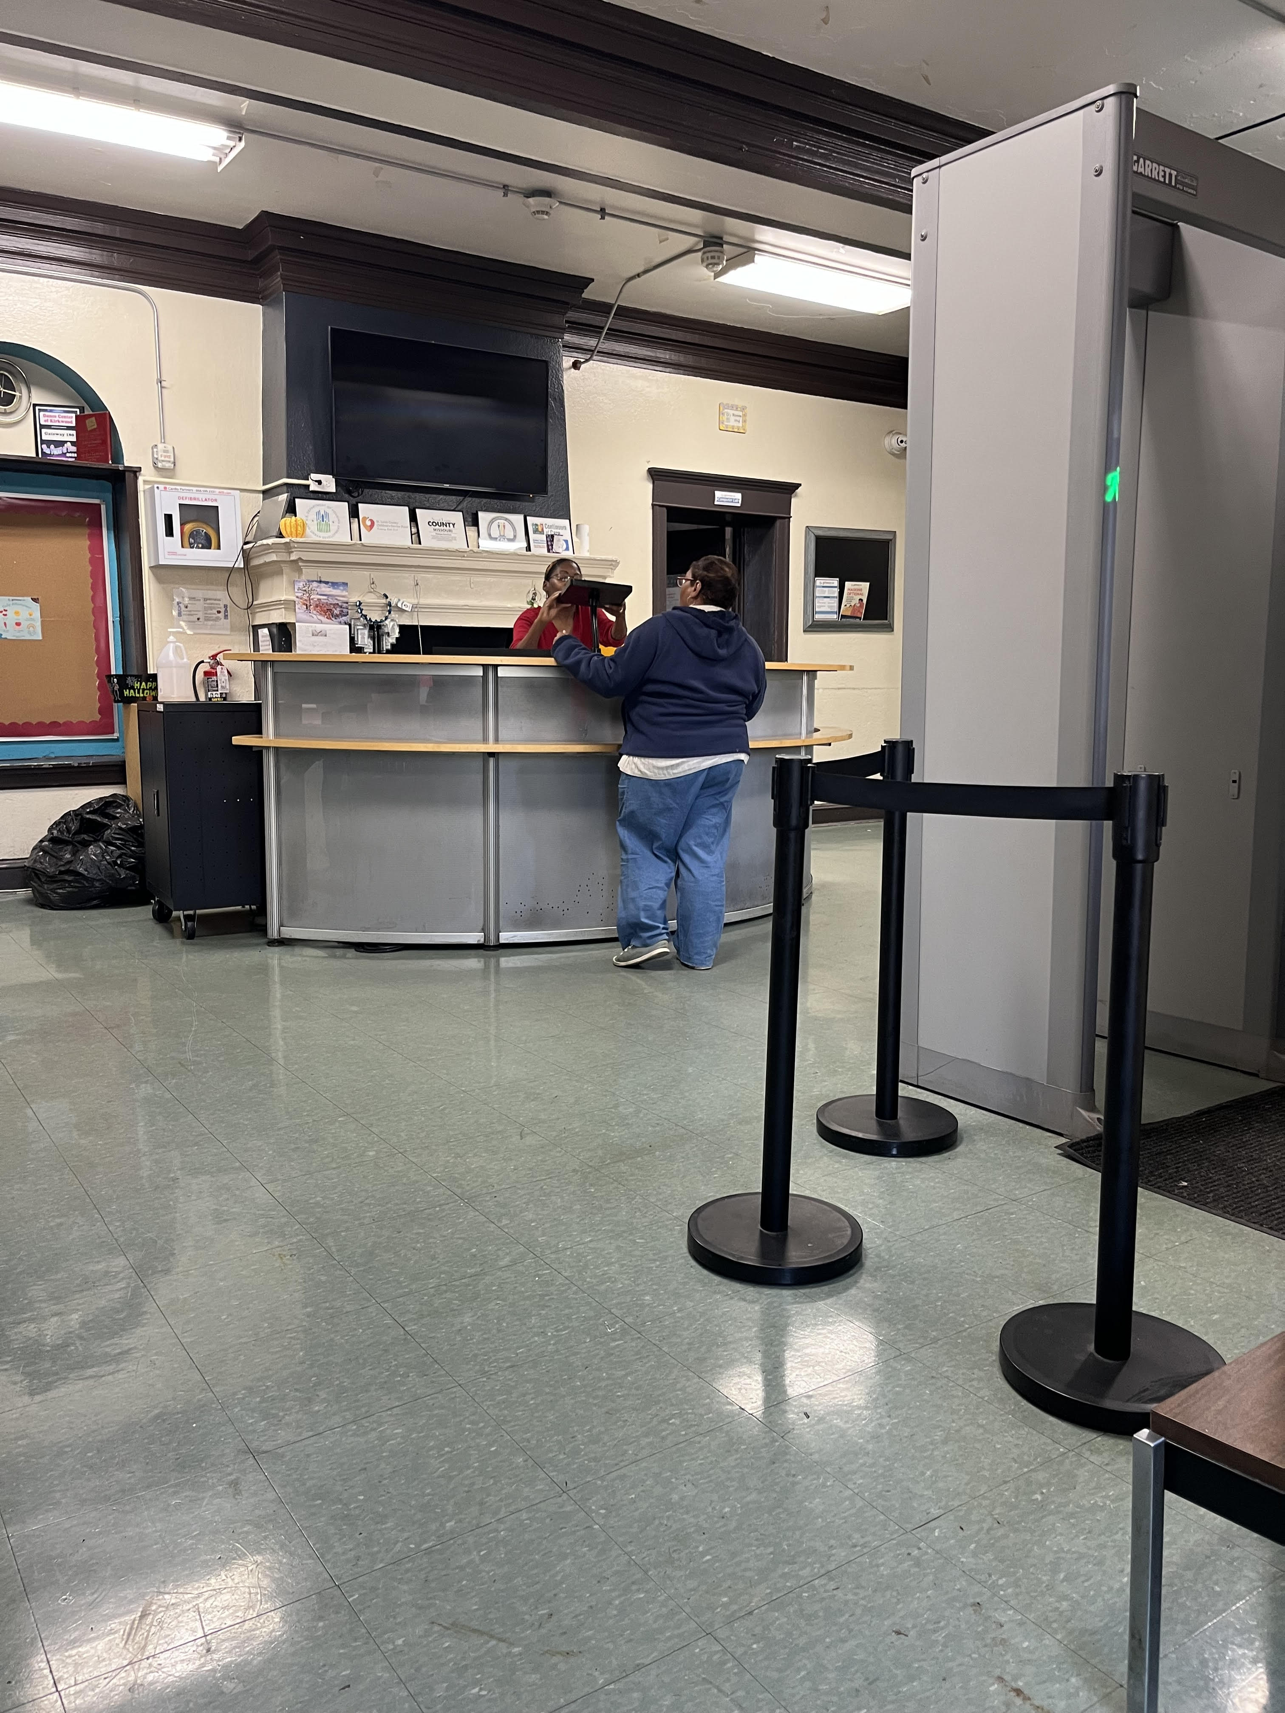
Outreach Update
We had discussed the woman living in her car at 5600 waterman in the previous meeting. We have had tremendous progress with her. We have been able to get her into gateway 180, a woman's shelter located downtown, this was With the help of an inside source we were able to put her at the top of the housing list for a bed. She now has secure housing for the next 90 days and if she works the program properly this will be extended.
We are in discussion of where to tow her vehicle so its no longer a nuisance to the residents on waterman, but also accessible to her If need be.

Slide 22
Outreach Update
This gentleman was laying in the middle of the Cortez. He stated he was tired from hitchhiking around the Midwest. He was originally from Sikeston MO wanting to get to Illinois. Alvin provided him a train ticket to get over to Illinois. Another example of St. Louis becoming a Hub for unhoused to stop.

