Slide 1
NSI Board Report
CWE NSI Board Meeting
July 2024
Prepared By: Sarah Wickenhauser

Slide 2
Agenda
Call to order
Meeting Minutes approval – vote
Financial Report – vote
NSI Staff Reports

Slide 3
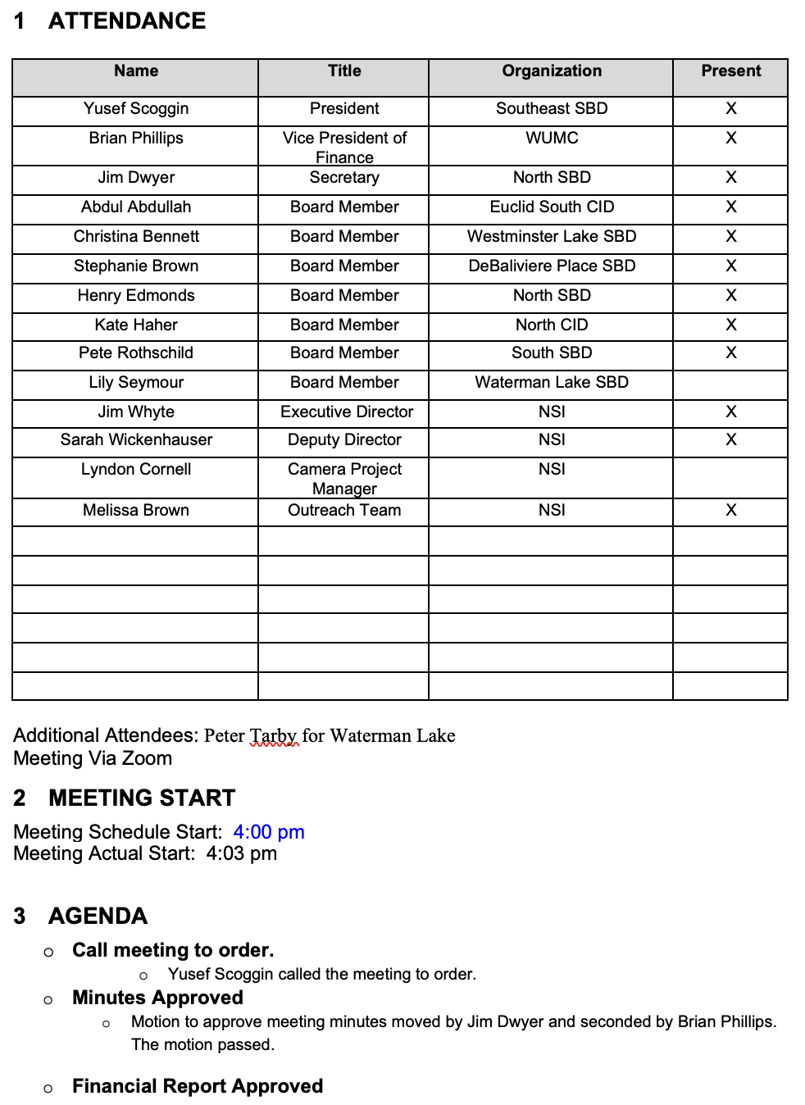
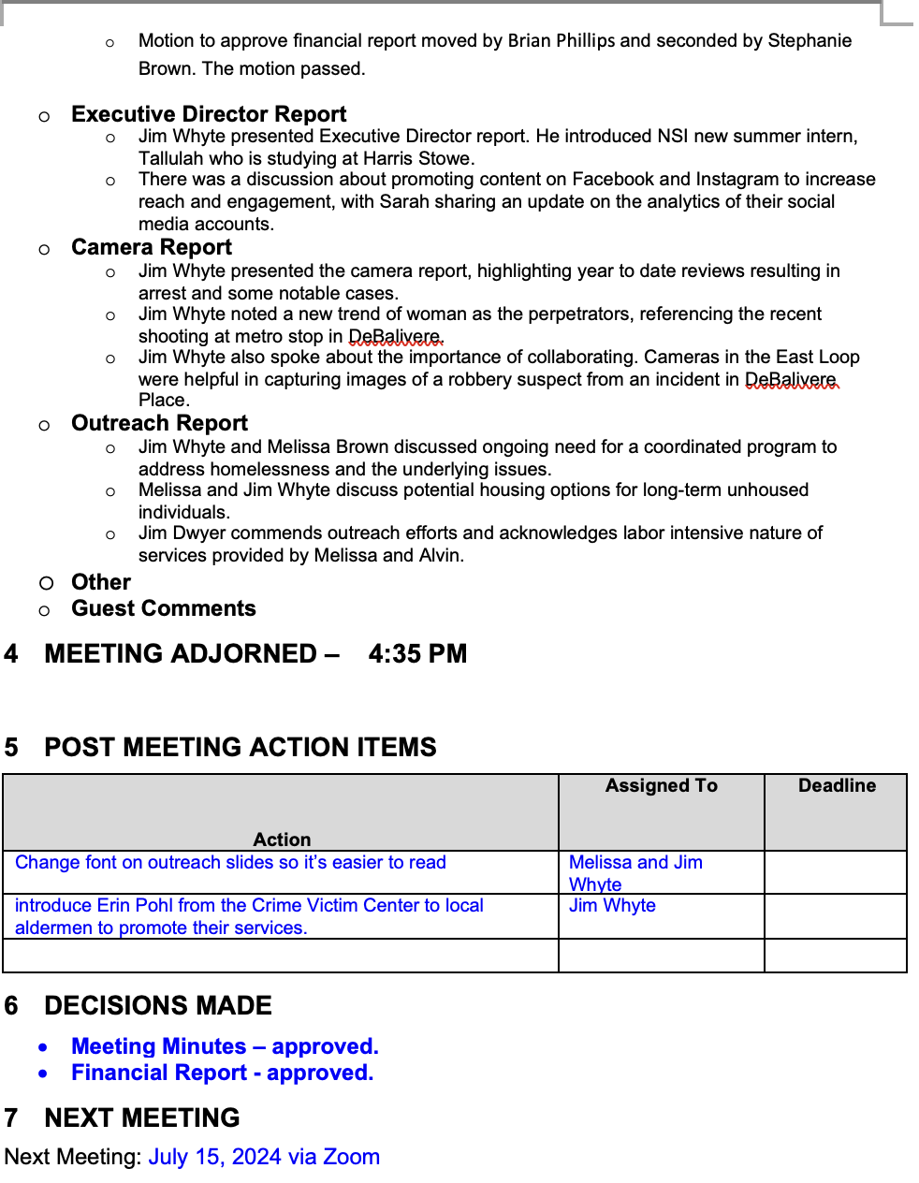
Meeting Minutes – June 2024

Slide 4
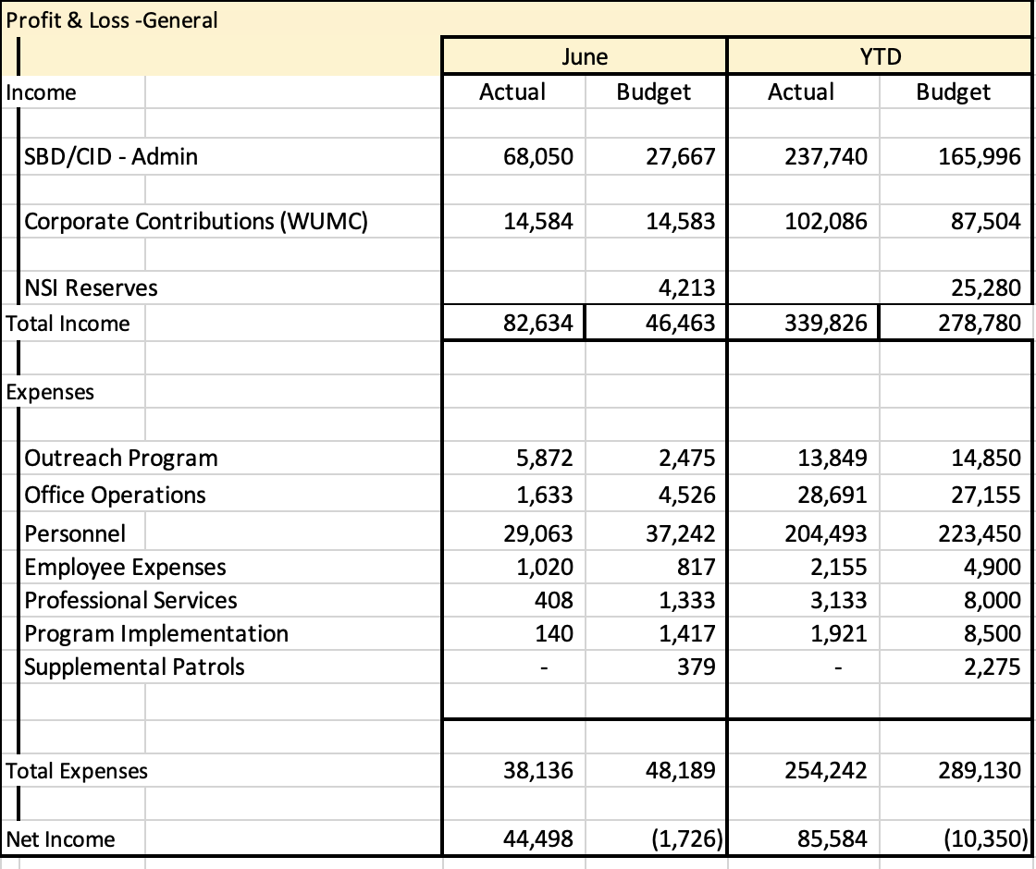
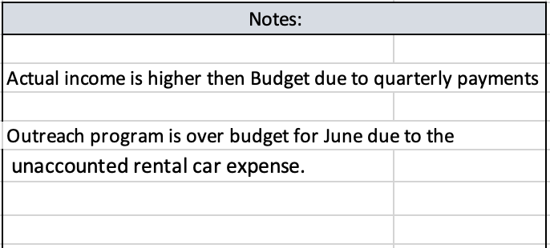
Financial Report – June 2024

Slide 5
Reports
Executive Director Report
Camera Report
Outreach Report –

Slide 6
CWE NSI Executive Director Report July 2024
Jim Whyte
The Central West End Neighborhood Security Initiative
447 N. Euclid Ave, St. Louis, MO 63108
jwhyte@cwensi.com
314.454.5808

Slide 7
Updates
I attended the West Pine Laclede Neighborhood meeting. I covered topics concerning unhoused, graffiti, dumpster divers, Outreach.
I was nominated and accepted the “Secretary” position on the Board of the St. Louis Crime Commission. The STLCC oversees St. Louis Regional CrimeStoppers. The Commission recently was awarded over $10 million dollars by the State of Missouri, to be used to eradicate dilapidated and dangerous properties which cannot be restored and plague neighborhoods in the City of St. Louis.
I would like the NSI to make an annual unrestricted donation, starting this year, to St. Louis CrimeStoppers, in the amount of $2,500. The money can be utilized for rewards, operational needs or other ways to meet the needs of the organization. I would also encourage other in-kind donations.
Through our new social media strategy, St. Louis CrimeStopper will be better utilized. Example, we previously waited on the SLMPD to release our video now we post it directly to our social media accounts and it’s picked up by CrimeStoppers.

Slide 8
Social Media Updates
Through our new social media strategy, St. Louis CrimeStopper will be better utilized. Example, we previously waited on the SLMPD to release our video now we post it directly to our social media accounts and it’s picked up by CrimeStoppers.
NSI Instagram Analytics Recap for June
Net Followers for the Month: Increased by 19 overall
Total Engagements: 29 (3% overall increase)
Top Performing Content: ● Safety Tips: Posts on safety tips, especially on mailbox theft, generated the highest reach and engagement.
NSI Facebook Analytics Recap for June
Net Followers for the Month: Increased by 11 overall
Total Engagements: 122 (69% increase)
Top Performing Content: ● Safety Tips: Posts on safety tips, especially on mailbox theft, generated the highest reach and engagement.

Slide 9
Social Media Updates
Recommendations for Next Month:
Focus more on action videos such as the homeless outreach team working and showcasing cameras.
Continue with talking head education videos. ●
Introduce more hands-on content, like "how-to" posts. ● Maintain the engagement strategy, as it has been yielding 2-6 new followers each week.

Slide 10
Simple IRA
I met with Joe Roddy with West End Advisory Group to discuss a simple IRA for employees.
There is a $25 annual fee per employee.
There are 2 options to participate. Employers may contribute either a flat 2% of your pay, regardless of whether you contribute, or match dollar-for-dollar what you contribute, up to 3% of your pay.
The flat 2% rate would cost the NSI $7,000.
The match dollar-for-dollar up to 3% of your pay would not exceed $11,000.

Slide 11
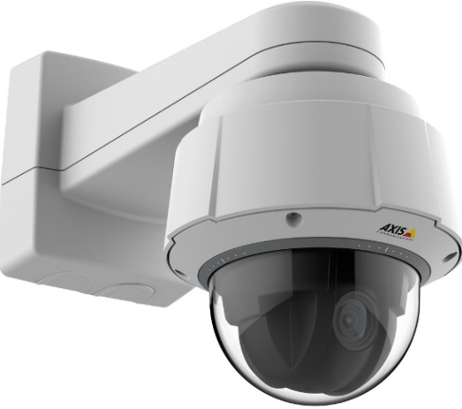
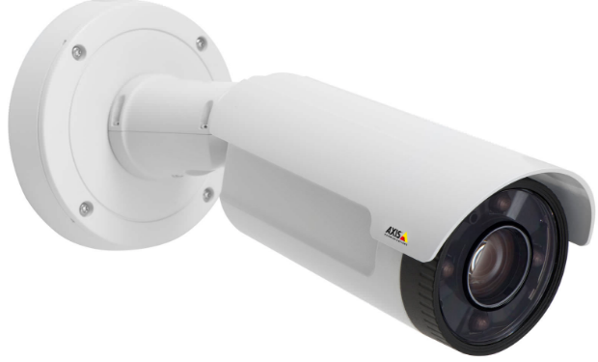
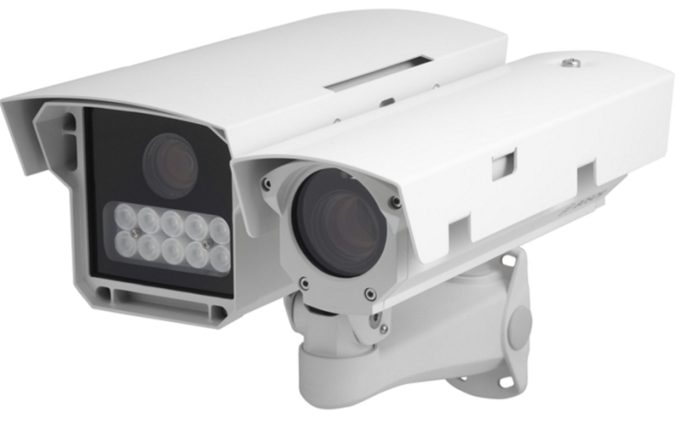
NSI Camera Project
July 15, 2024

Slide 12
Camera Management Information:
The Central West End neighborhood has 31 camera sites with 202 cameras having 353 views and 1 Flock camera.
DeBaliviere has 6 sites with 40 cameras having 68 camera views.
FPSE has 15 sites with 75 cameras having 171 camera views and 4 Flock cameras.
Loop East: (2) Camera sites with 10 cameras with 26 camera views.
Total Number of Camera Sites: 54
Total Number of Cameras: 327
Total Number of Camera Views: 618
Total Number of Flock Cameras: 5

Slide 13
Camera Review Information
From January 1, 2024 to July15, 2024
Total camera reviews: 80
Total arrests relative to reviews: 26
Total wanted(s): 2
Total vehicle wanted(s):

Slide 14
Pending Camera Projects
4255 West Pine (Rejis)- Upgrade external cameras on building and install pole at intersection- On Hold.
4321 Chouteau- Establish a new camera site. Complete
4476 Chouteau (Song Bird)- Complete.
Recommendation for Camera upgrades and establish new sites in the CWE South SBD and Euclid South CID.

Slide 15
Pending Projects continued
398 N. Euclid- Establish a new camera site at this location. (Conduit and wiring installed)
625 N. Euclid- Establish New site. Complete
4500 Olive- Establish a new camera site. Install date 7/22/2024

Slide 16
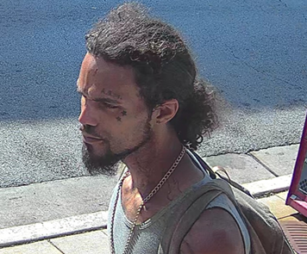
24-025249 Stealing of an E-Bike from 4577 West Pine on 6/17/2024 at approx 9:21 am
The NSI received information about the theft of a E-Bike.
Video review was conducted.
The victim stated he parked his E-Bike on the west side of Whole Foods and later discovered it was stolen.
The victim described the bike as being black with blue trim and having a saddle bag on the back.
The video shows a suspect walking north on Euclid from Forest Park Ave prior to the theft.
The suspect was last seen travelling east in the north alley behind 4255 West Pine out of sight.

Slide 17
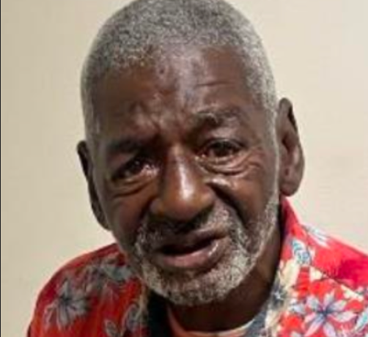
Larceny/Shoplifting Maine Squeeze Juice Co. 310 N. Euclid on 6/17/2024 at 1:30pm
The manager at Main Squeeze Juice Co., 310 N. Euclid, reported as shoplifting incident involving a subject the NSI identified as Ned C. Gibson, Jr., b-m, dob: 05/19/1950.
The business manager, Alex Kamakas,cell (314)814-2478, stlouis.euclid@mainsqueezejuiceco.com, work (314)802-8961, further reported this one of several shoplifting incidents which has impacted his staff’s peace of mind and personal safety.
Manager was advised to file a police report considering the many incidents and interactions involving Gibson.

Slide 18
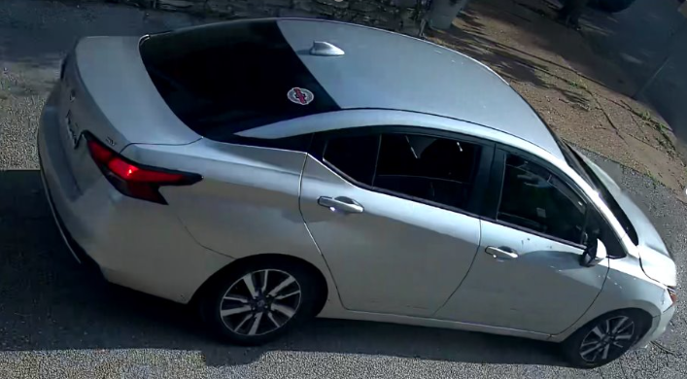
24-026872​ Stealing from a Person ​#10 N. Newstead on​ 6/27/2024 at approximately 6:25 pm​ ​
The NSI received information relative to a Person having her money stolen in the area of Newstead and Laclede on 6/27/2024 at approximately 6:25 pm.​
Victim was walking near the intersection of Newstead and Laclede when a vehicle stopped next to her.​
The suspects asked the victim a question and when she was standing next to the vehicle the suspect forcefully stole $700 from her pocket.​
The vehicle fled north on Newstead out of sight.​
The NSI conducted a camera review at which time the vehicle the suspects used was observed to be a small silver Nissan being a “Travers” placard on the front and a temp tag on the back.​
After the incident the vehicle fled north on Newstead and west in the alley. The vehicle turned north from the alley onto Taylor and was last observed travelling east on Lindell out of sight.

Slide 19
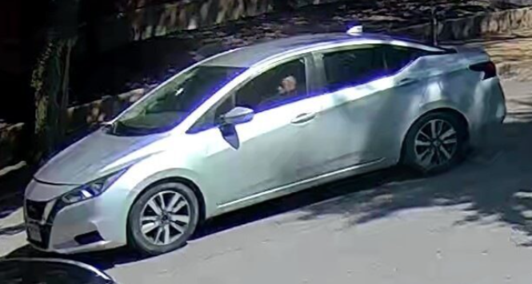
24-027194 Stealing from a Person from 4403 Laclede on 6/29/2024 at 3:25 pm
The NSI received information relative to a suspect who stole the victim's vehicle in a robbery.
When the victim went into the gas station the suspect jumped into her car and was able to drive away.
The victim was injured when she attempted to stop the fleeing suspect and car.
A review of the cameras in the area revealed the suspects were occupying a silver Nissan.
These suspect are also responsible for another robbery that occurred in the same area two days prior.

Slide 20
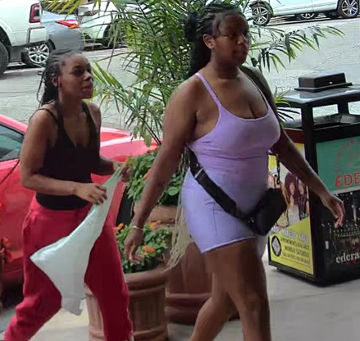
24-027550​ Theft​ #26 Maryland Plaza (Lululemon)​ on 7/1/2024 at 4:42 pm
The NSI received information about the theft from Lululemon.​
Video review was conducted.​
The video shows a red Camero bearing Illinois license plate “DJ 62044” driving east on Maryland from Kingshighway before stopping in front of the store.​
2 female suspects exit the passenger side of the vehicle and enters the store.​
Approximately 1 minute later the females exit the store carrying arms full of stolen items and re-enters the Camero.​
The vehicle then drives south on York and west on Lindell out of sight.

Slide 21
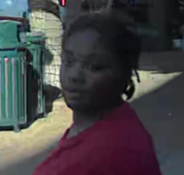
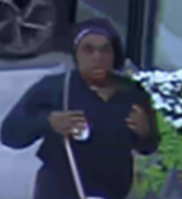
24-027696 Theft #26 Maryland Plaza (Lululemon) on 7/2/2024 at 6:28 pm
The NSI received information about the theft from Lululemon.
Video review was conducted.
The video shows a black Volkswagen Passat bearing Missouri license plate “ZG5 Z9J” driving east on Maryland from Kingshighway before parking on York.
3 female suspects exit the vehicle and enters the store at 5:52 pm.
At 6:28 pm the females exit the store carrying arms full of stolen items and re-enters the Volkswagen.
The vehicle then drives south on York and west on Lindell out of sight.
Based of the video review 2 of the 3 females suspects were identified and arrested.

Slide 22
NSI Outreach: June-July 2024 Update
Alvin Ferguson & Melissa Brown

Slide 23
61 Total Individual Engagements between June-July 2024

Slide 24
Locations of CWE NSI Outreach Engagements between June-July 2024:

Slide 25
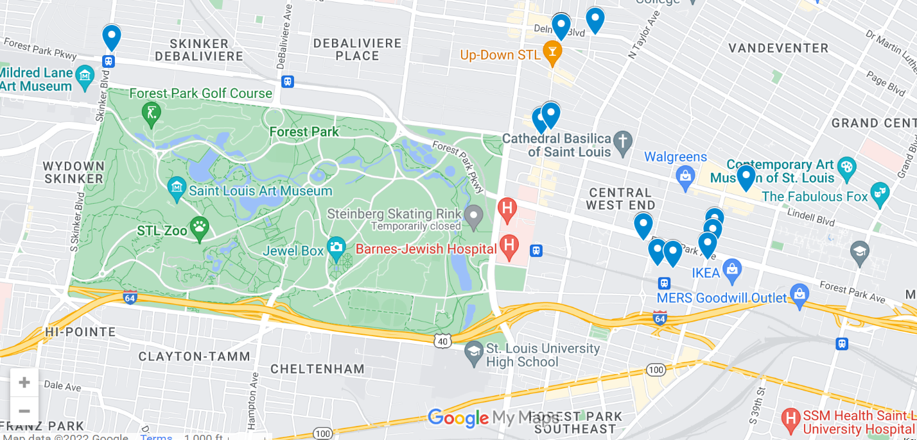
Maps – All Engagements

Slide 26
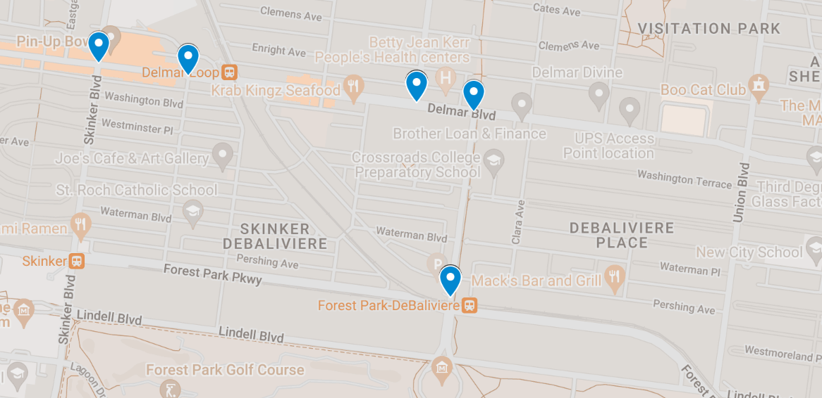
Maps – East Loop, DeBaliviere Place

Slide 27
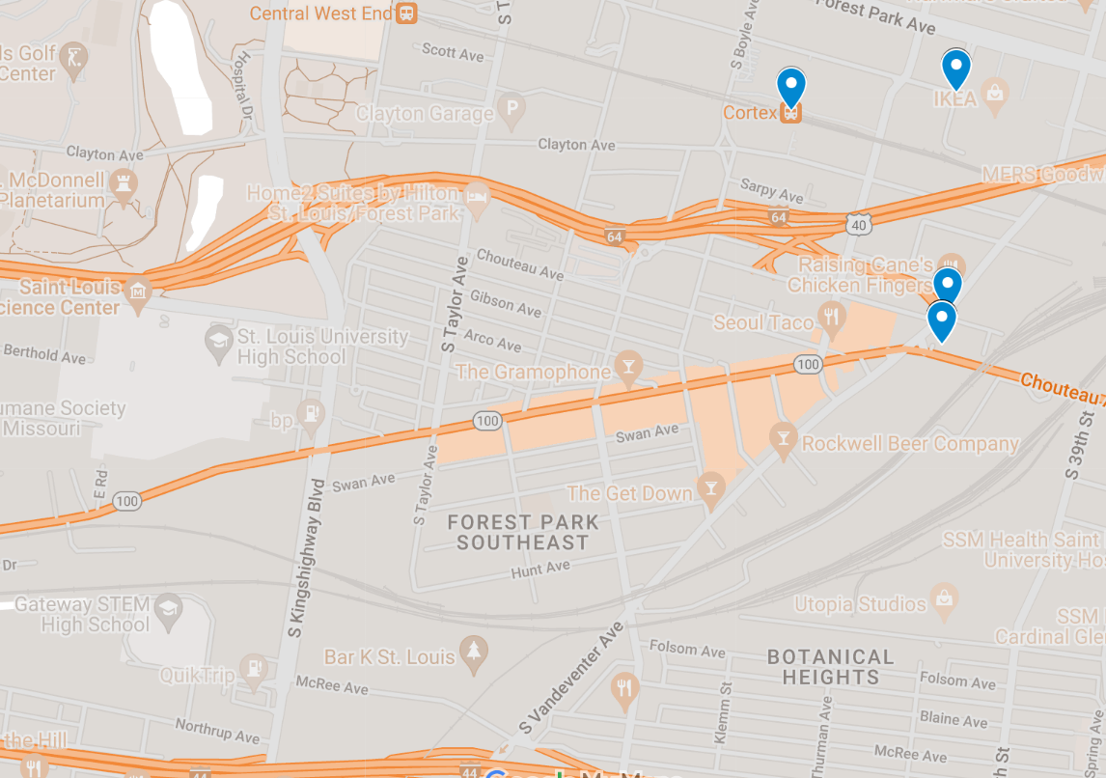
Maps – FPSE

Slide 28
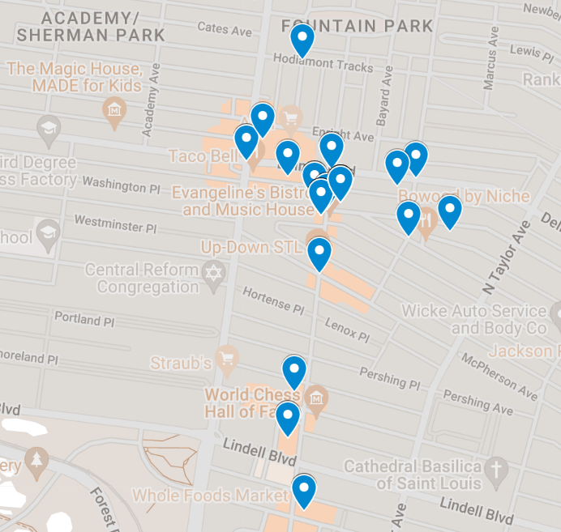
Maps – Northern Area

Slide 29
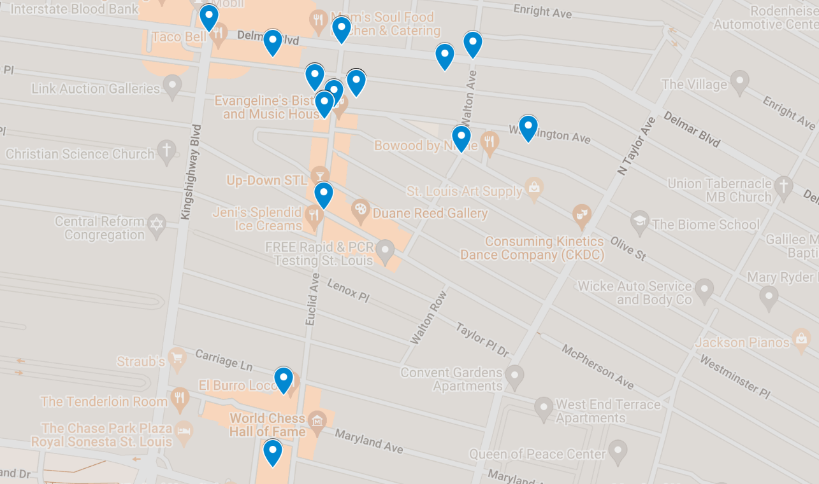
Maps – CWE North SBD

Slide 30
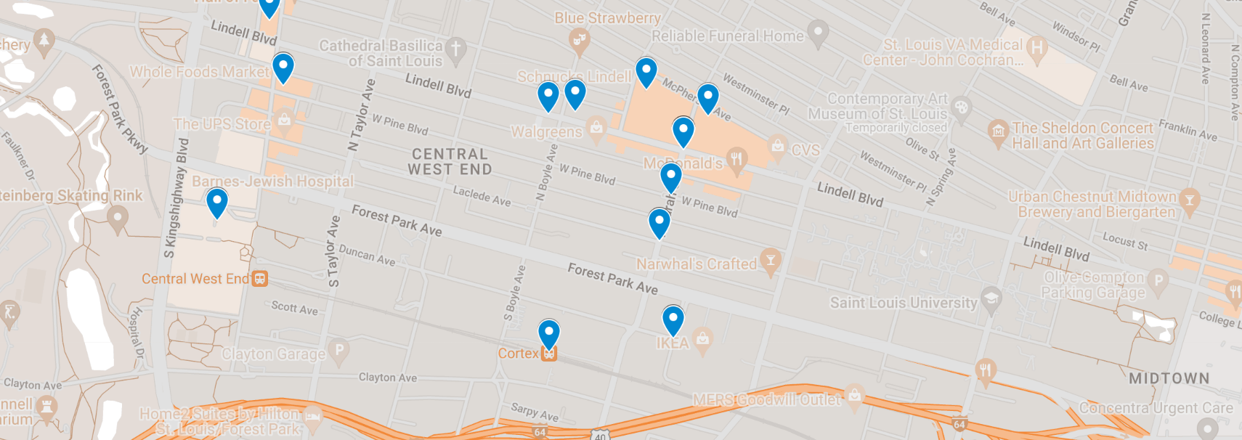
Maps – CWE Southeast SBD, Cortex

Slide 31
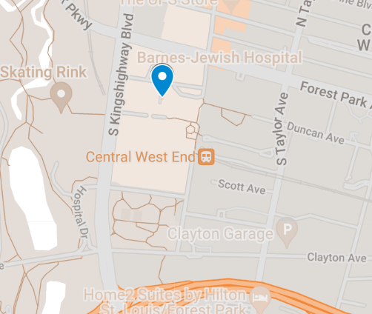
Maps – Medical Campus

Slide 32
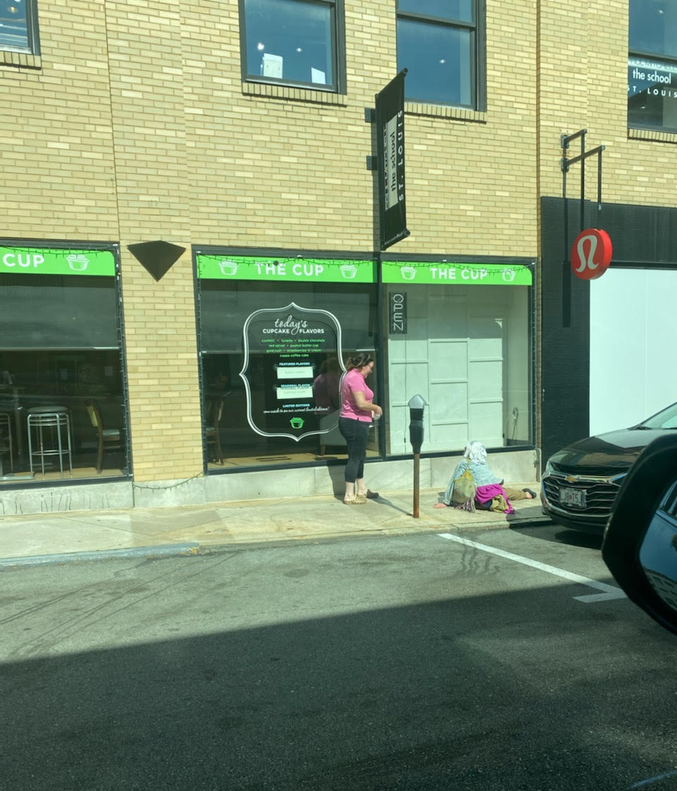
Community Interaction
Jim received a call from the cup about a lady staring into their window. She was sitting there talking to herself in the reflection but was open to talking with me and very friendly. Based on the conversation she had been unhoused for some time and suffering with a mental illness. She wanted to get back to south city where she was familiar. I was able to get her across the street and give her food and bus tickets. This prompted her away from the business while being able to help as well.

Slide 33
Outreach Update
This man is a double amputee who was stranded because his wheelchair died and he was unable to find a port to charge it. Alvin was able to assist him in charging the wheelchair to be mobile again. The man and his wife stated they previously had an apartment but were unable to access because the unit was on the second floor, and it was not handicap accessible. Stated they were homeless before he lost his legs as well, and that Mercy took his legs without permission and he now has a lawyer. It was complex story that had some questionable information, but regardless of this Alvin did his job in assisting them and showing empathy.

